Slide 1
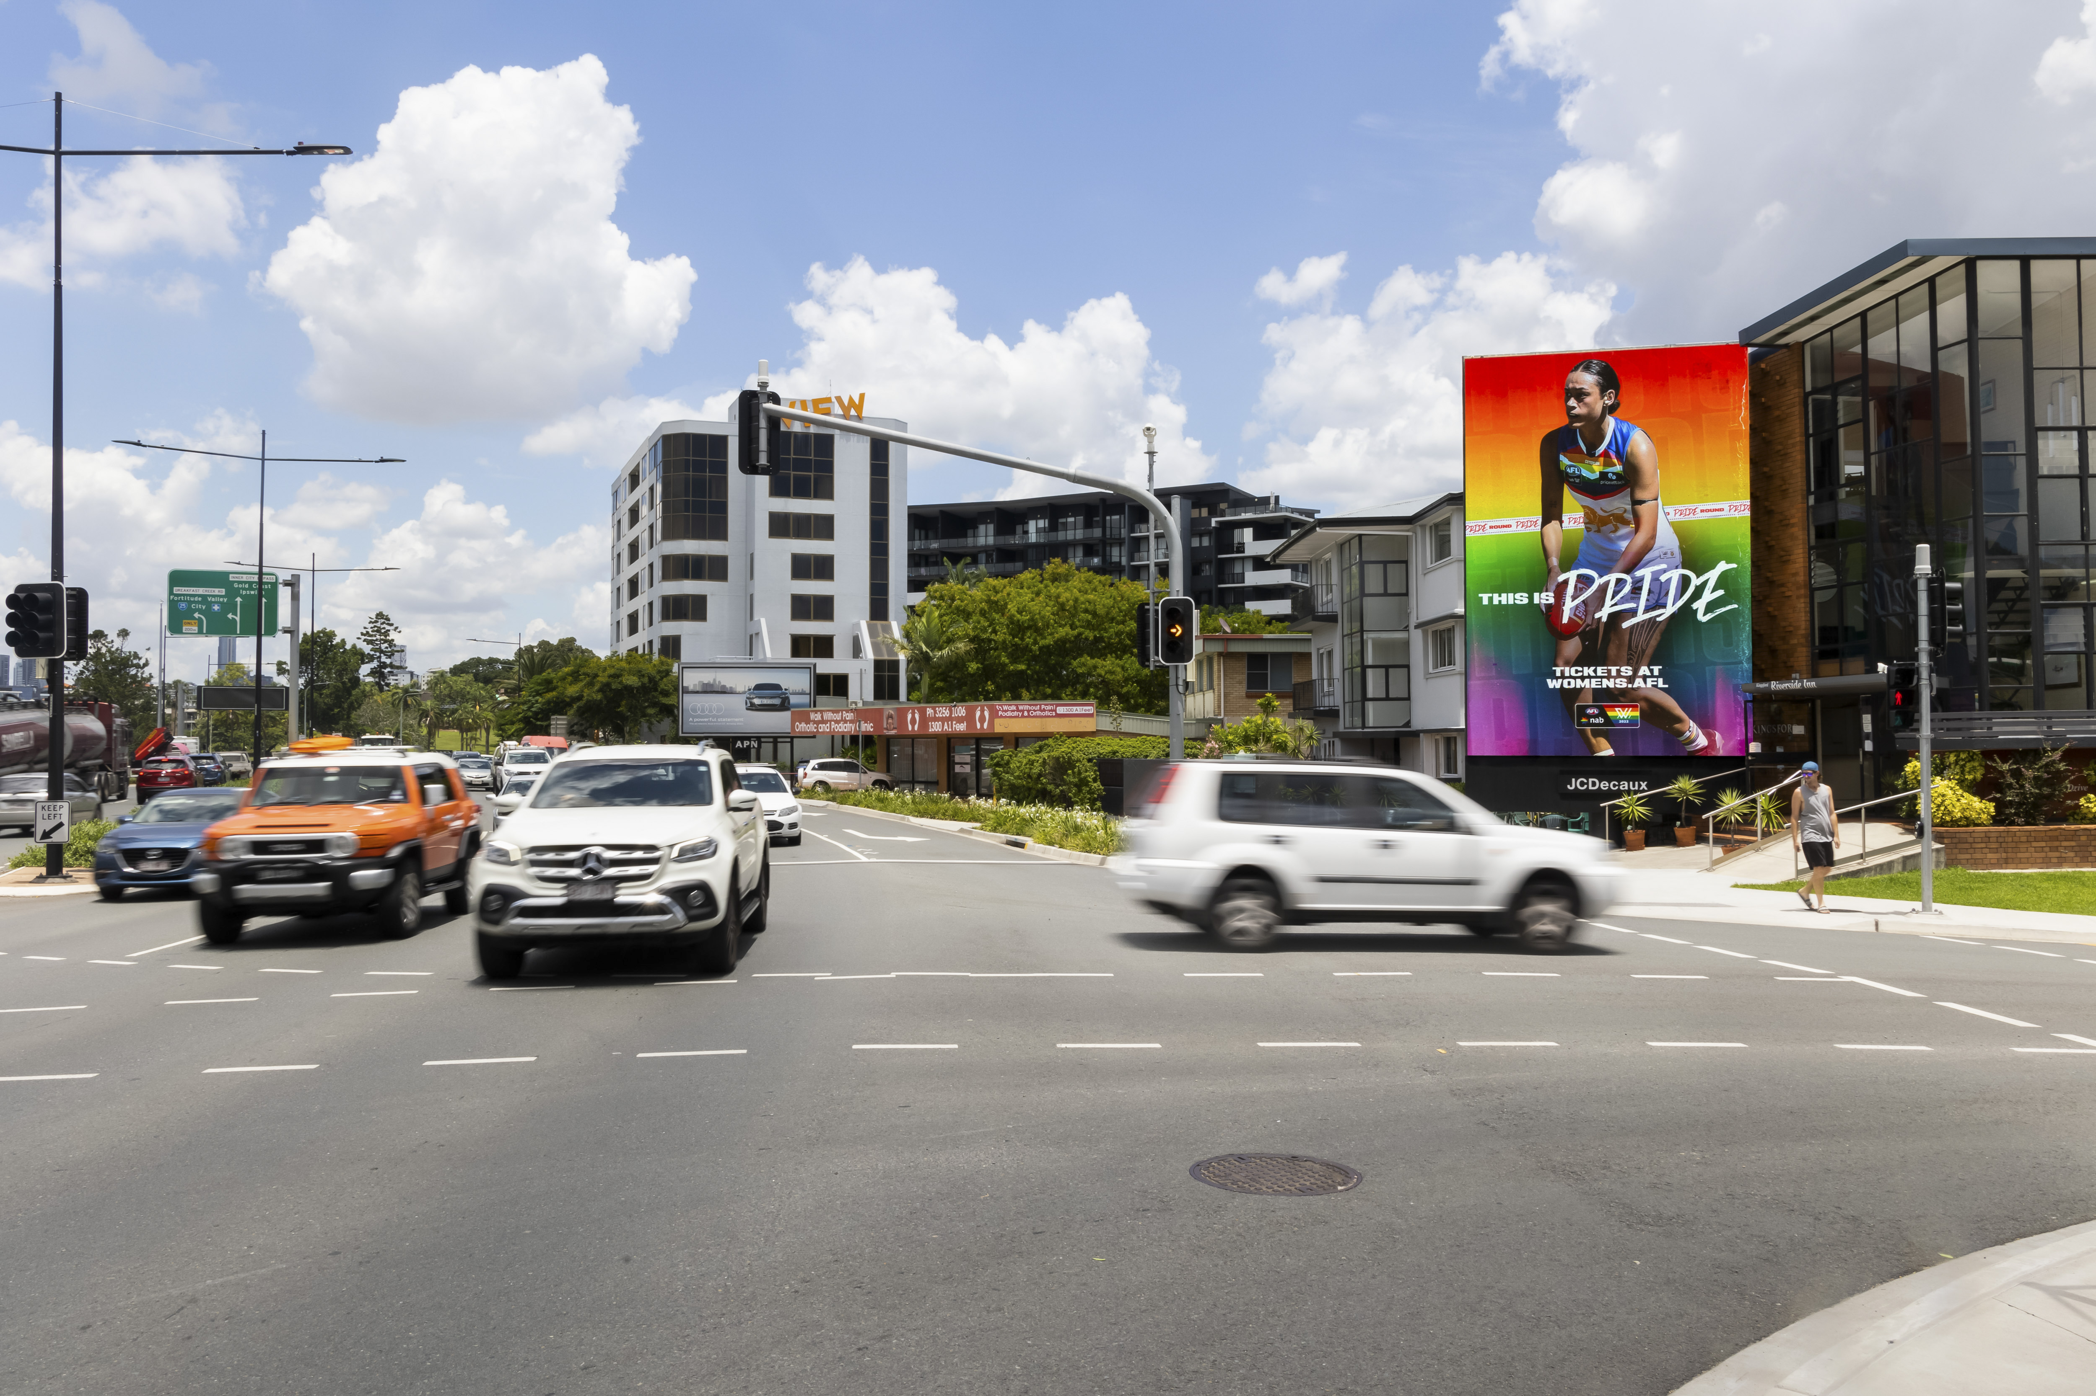
Out of Home is part of the daily commute (again)
June 2022

Slide 2
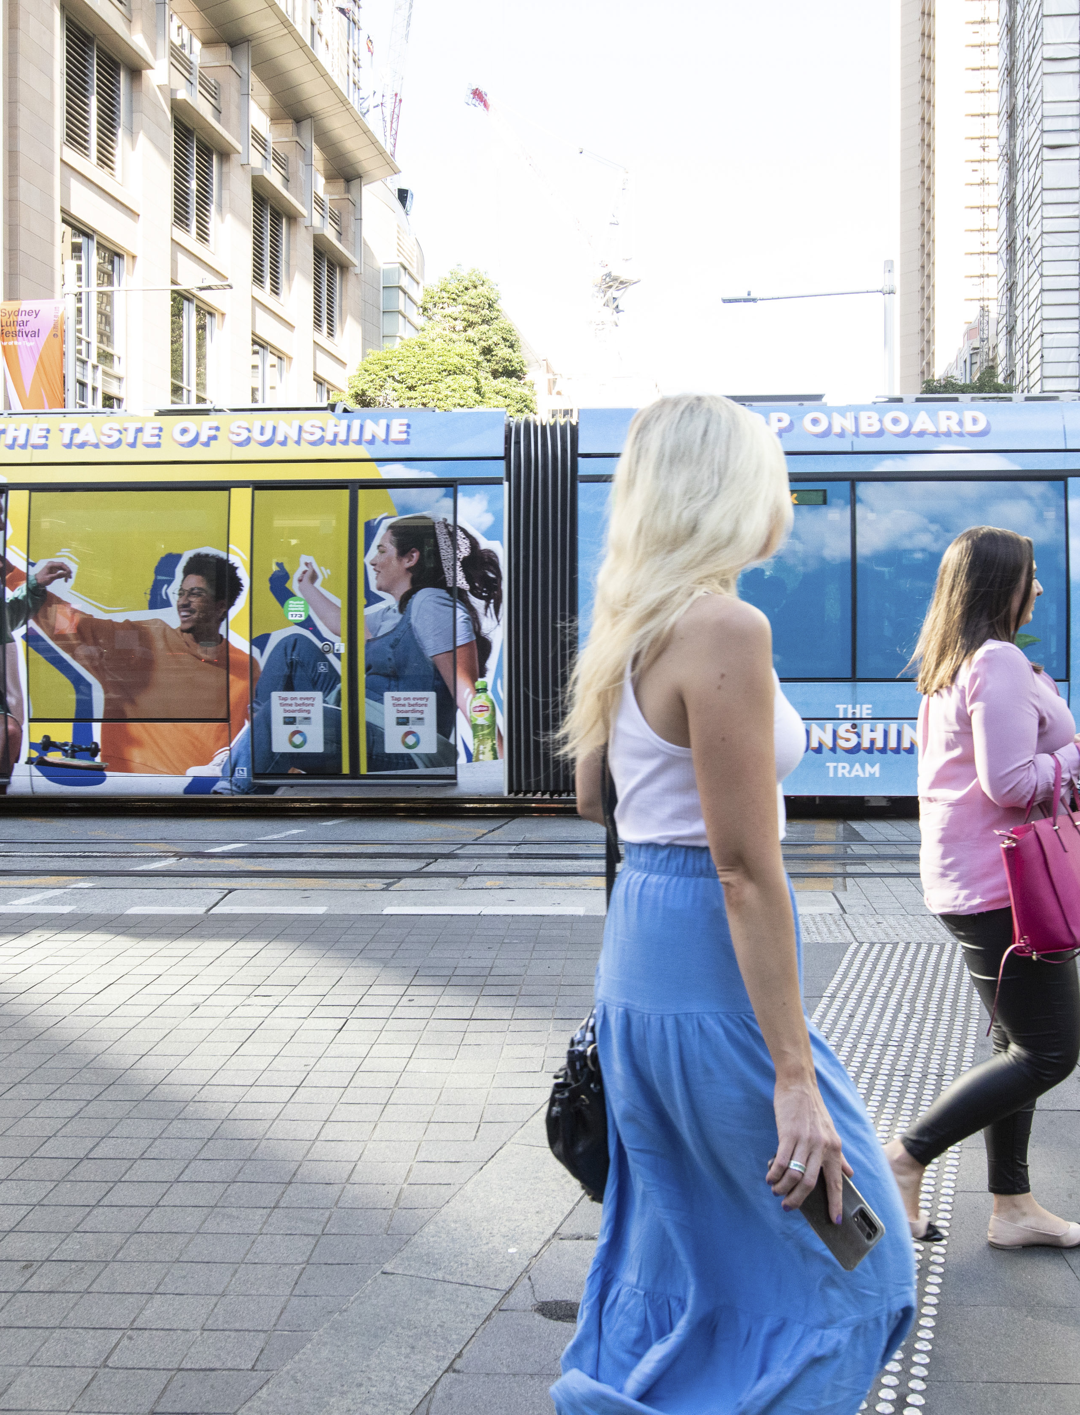
Out of Home is remembered by commuters
Research and data company GWI (formerly GlobalWebIndex) conducts a monthly survey to zero in on up-to-the-moment data. The recently published December 2021 survey asked respondents whether they recalled seeing Outdoor advertising on their last commute.
We have connected this data to a second study done by Kinetic and Exterion in the UK which looks at how Out of Home advertising influences commuters.
Sources: 1) GWI Zeitgest December 2021 – Nine (9) markets: UK, US, France, Germany, Italy, India. Brazil, Japan and China. 7,228 full office-based or hybrid worker aged 16-64 were asked During your last commute to work, do you recall seeing ads on any of the following? 2) Kinetic and Exterion in partnership with the Centre for Business and Economics Research (Cebr) based on 1,500 frequent commuters using public transport.

Slide 3
Roadside billboards are the most remembered (all commuters)
of all commuters recall seeing a roadside billboard on their most recent commute
of all commuters recall seeing advertising on a bus, bus station, or a bus stop
Source: GWI Zeitgest December 2021 – Nine (9) markets, UK, US, France, Germany, Italy, India. Brazil, Japan and China
7,228 full office-based or hybrid worker aged 16-64 were asked During your last commute to work, do you recall seeing ads on any of the following?

Slide 4
Bus & train ads are most memorable (public transport commuters)
of bus commuters recall seeing Out of Home on buses, in bus stations or at bus stops
of train commuters recall seeing Out of Home on trains or in train stations
Source: GWI Zeitgest December 2021 – Nine (9) markets, UK, US, France, Germany, Italy, India. Brazil, Japan and China
7,228 full office-based or hybrid worker aged 16-64 were asked During your last commute to work, do you recall seeing ads on any of the following?

Slide 5
Car-poolers have higher recall overall compared to walkers or drivers
Source: GWI Zeitgest December 2021 – Nine (9) markets, UK, US, France, Germany, Italy, India. Brazil, Japan and China
7,228 full office-based or hybrid worker aged 16-64 were asked During your last commute to work, do you recall seeing ads on any of the following?

Slide 6
70 per cent of UK commuters said they were influenced to buy
of UK train commuters said they made purchases after being influenced by Out of Home ads on their journey
said they used their phones to shop at least four times a month.
Source: Kinetic and Exterion in partnership with the Centre for Business and Economics Research (Cebr) based on 1,500 frequent commuters using public transport; published by WARC January 2022.

Slide 7
More research and insights may be found at Anatomy of Out of Home

