Slide 1
Out of Home
Creative
Guidelines
September 2022

Slide 2
Harness the power of a glance
We know Out of Home (OOH) has impact, but how important is the creative execution?
We’ve been researching creativity and impact, trying to find the sweet spot where OOH campaigns are most effective. And the results are in – the OMA Creative Guidelines show best practice and scientific evidence for how to create an effective OOH campaign.
Read here.

Slide 3
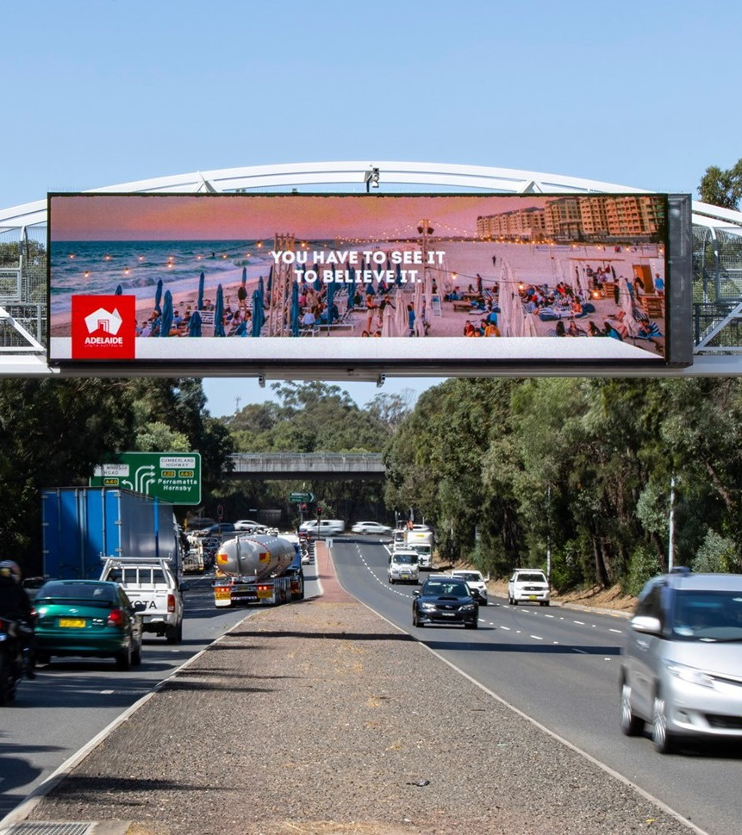
Decisions are made subconsciously
95%
of purchase decisions are subconscious.
Source: How Customers Think: Essential Insights Into the Mind of the Market, by Gerald Zaltman. Harvard Business School Press, 2003.

Slide 4
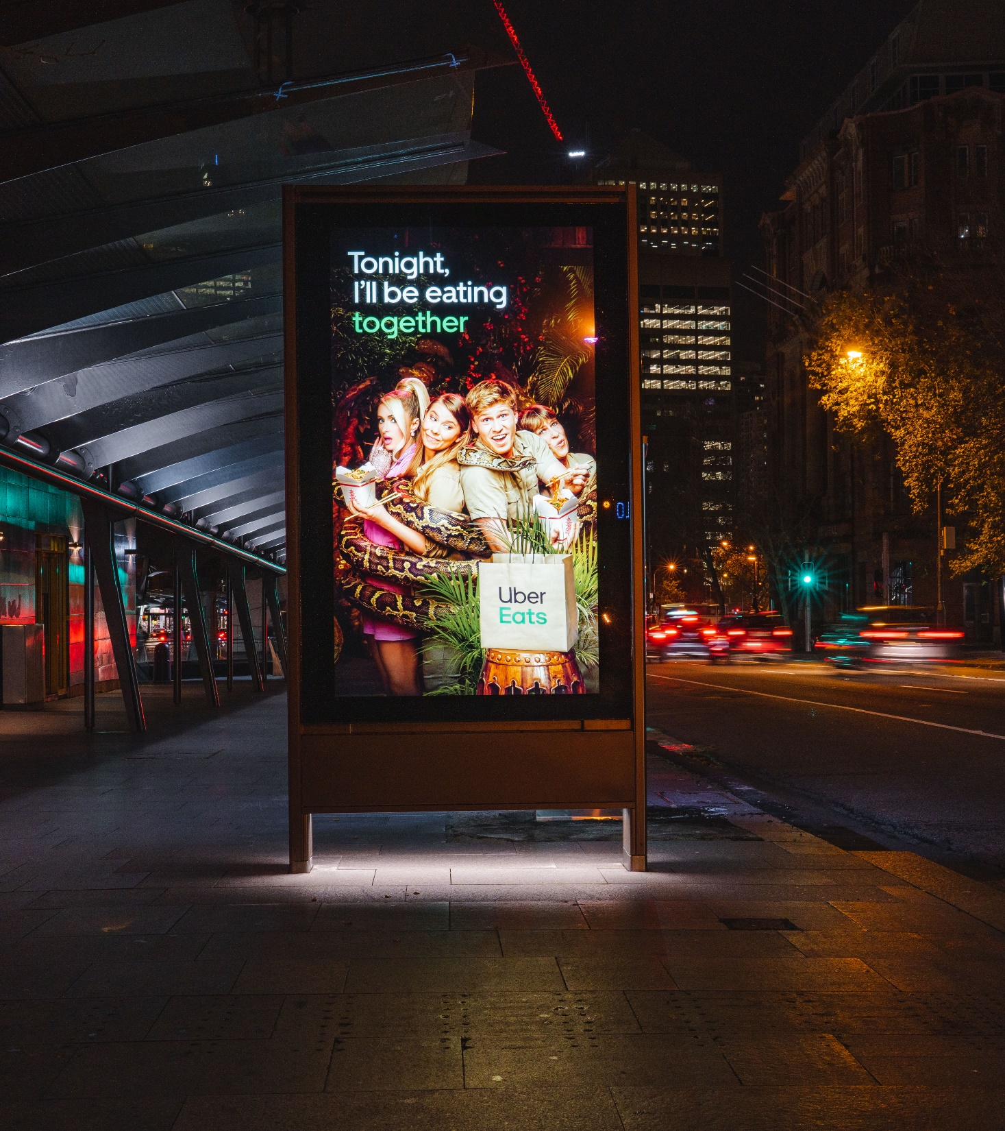
Evolving creative delivers higher impact
38%
Evolving creative in a campaign delivers 38% higher impact compared to static campaigns with singular creative execution.
Source: Neuro Insight OOH Case Study with QMS neuro–insight.com/casestudy/ooh–study–with–qms

Slide 5
Campaigns are more effective using three or more formats
Source: Analytic Partners Meta Analysis, New Zealand, 2015 to 2021.

Slide 6
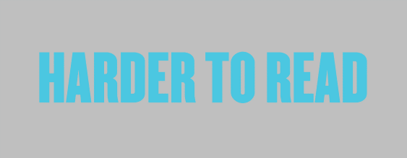
Colour contrast is vital
Strong contrast
in colours draws more attention. Use dark text on light backgrounds or light text on dark backgrounds

Slide 7
7 words
or less should be used.

Slide 8
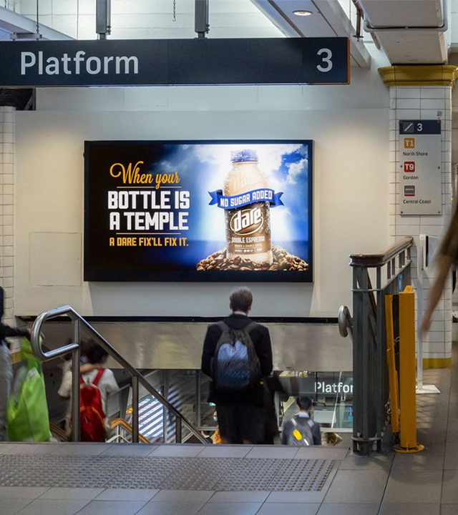
Digital signs have a higher impact
63%
Digital signs have 63 per cent more impact than classic signs; classic signs deliver higher reach because your advertisement owns that space.
Source: The Neuro Impact Factor, OMA Whitepaper 2022

Slide 9
More research and insights may be found at Anatomy of Out of Home

