Slide 1
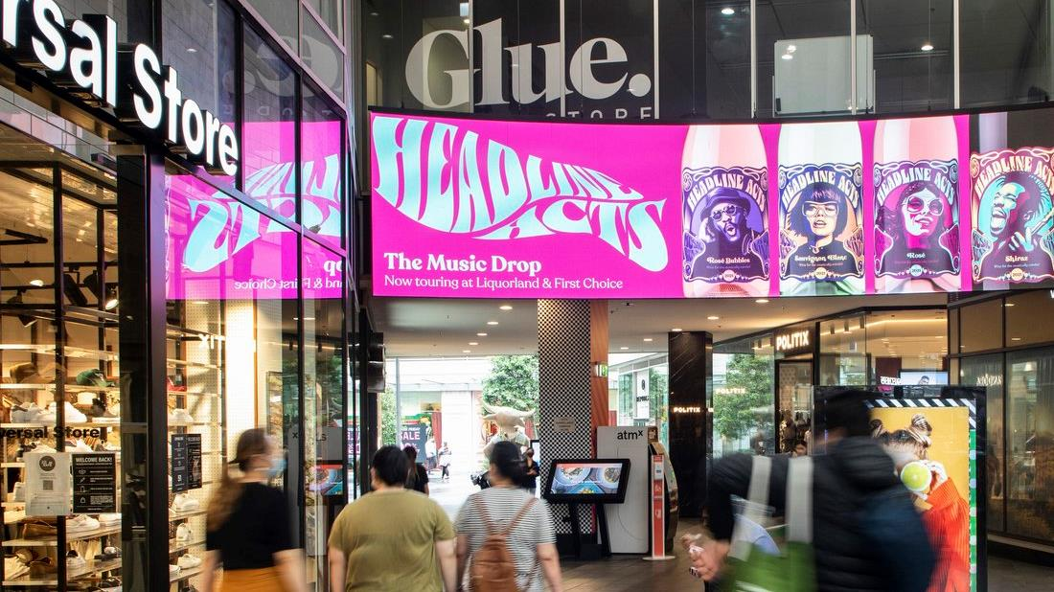
Special
End of Year Edition
December 2022

Slide 2
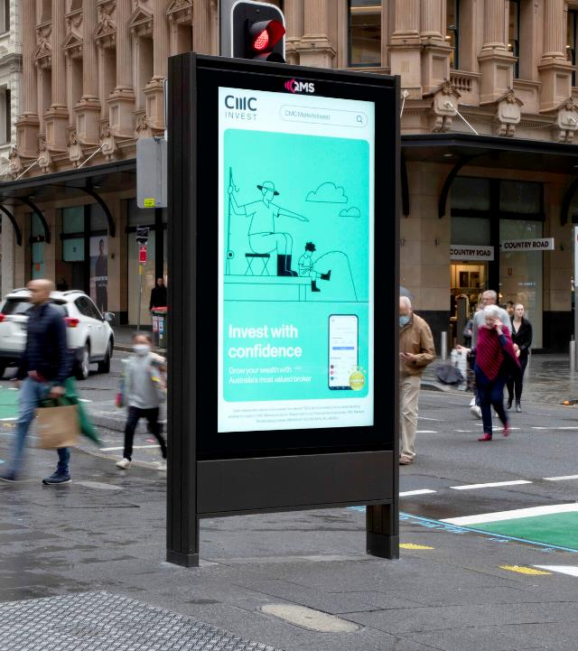
Take your brand Out of Home this summer
It’s been a big year for Out of Home (OOH) advertising. This month we bring you the highlights of industry research proving the efficacy and importance of OOH in any marketing mix. Read on to find a range of research and stats to help you with your media planning.

Slide 3
Always on, even in summer when …
2 of 3
major media channels go dark. TV and radio have non-survey periods and key talent go off-air. Just as people are out and about, enjoying their holidays with time to spare.
Source: Collected Mix Models from The Leading Edge & Analytic Partners 2002-2018. Confidential & Proprietary. © 2019 analytic Partners, Inc.

Slide 4
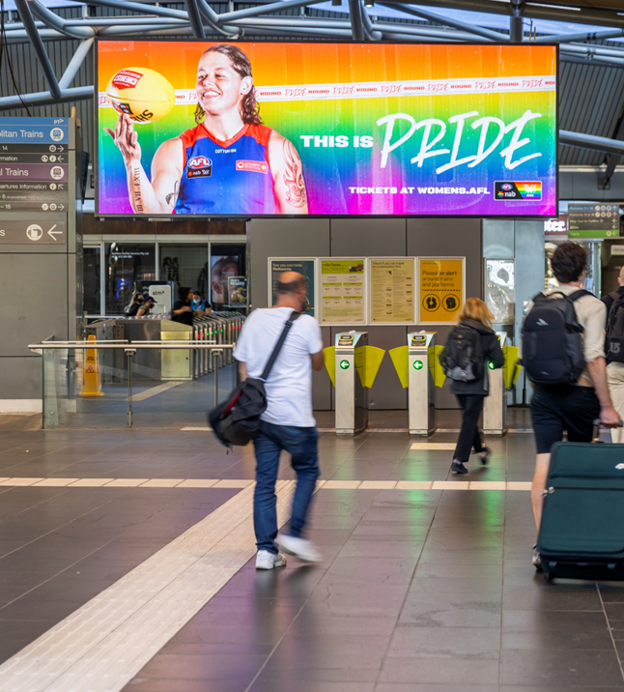
People remember OOH more now than before the pandemic
43%
Adults notice OOH ads more now than before the pandemic.
Source: AdWeek, Esther Raphael, 2022 Out-of-Home Ads Remain Effective in the Face of Inflation – Adweek (ampproject.org)

Slide 5
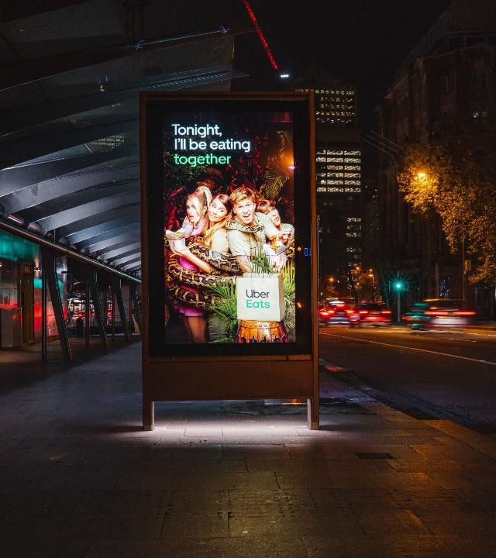
Evolving creative delivers higher impact
38%
Evolving creative in a campaign delivers 38% higher impact compared to static campaigns with singular creative execution.
Source: Neuro Insight OOH Case Study with QMS neuro–insight.com/casestudy/ooh–study–with–qms

Slide 6
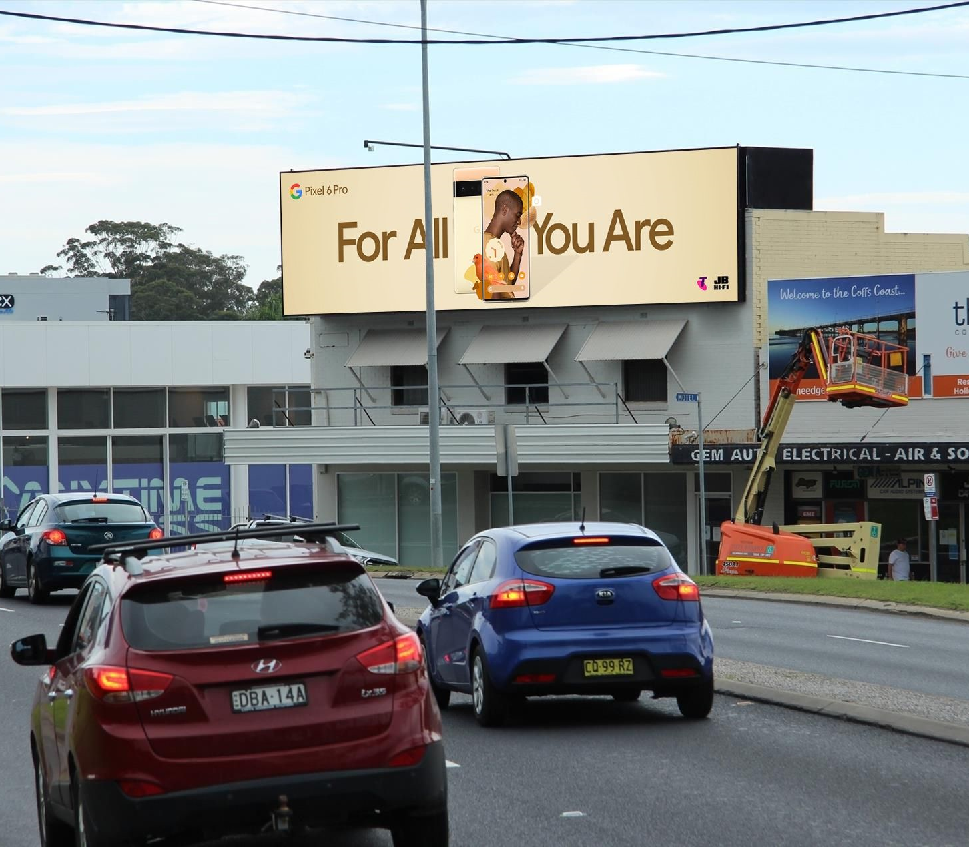
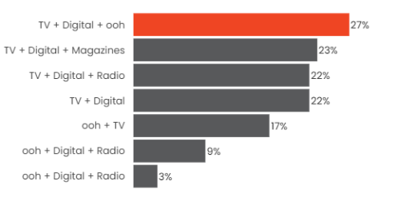
Combining OOH, TV and Online gets best ROI results
The 3-channel mix of TV, Digital and OOH gets the best ROI results in Australia by 27%
Source: ROI 3.0 The Foundations of Market Mix Success, Analytic Partners 2019

Slide 7
Out of Home campaigns are more effective using three or more formats
Source: Analytic Partners Meta Analysis, New Zealand, 2015 to 2021.

Slide 8
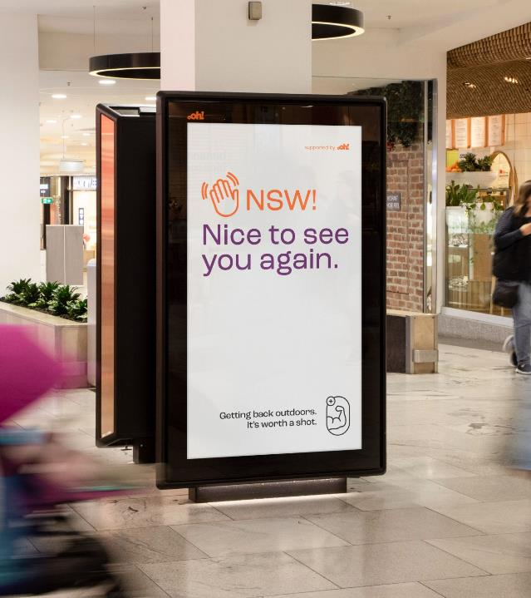
DOOH is immediate and relevant
61%
Digital Out of Home (DOOH) currently accounts for 61 per cent of total OOH industry expenditure.
Source: QMS and Neuro-Insight, Global First Neuro Study: Evolving Creative is More Memorable; May 2022.

Slide 9
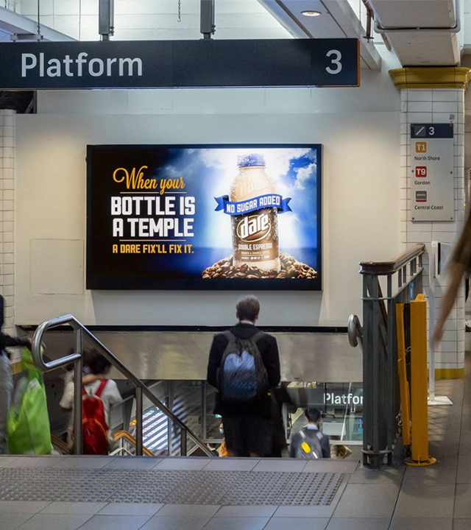
Digital signs have a higher impact
63%
Digital signs have 63 per cent more impact than classic signs; classic signs deliver higher reach because your advertisement owns that space.
Source: The Neuro Impact Factor, OMA Whitepaper 2022

Slide 10
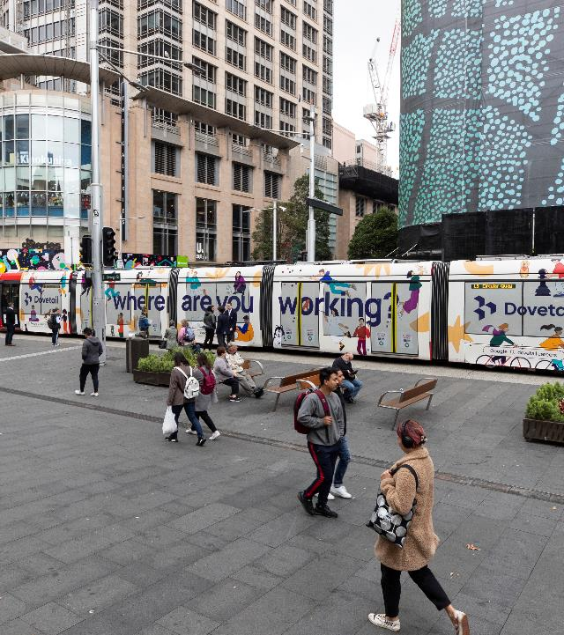
Online companies are spending more on traditional advertising
+11.7%
Marketers are anticipating an increase of 11.7*per cent spend over the next 12 months on traditional media channels.
* Companies that earn 100 per cent of their sales through the internet.
Source: Harvard Business Review, 2022: Why Marketers are returning to traditional advertising

Slide 11
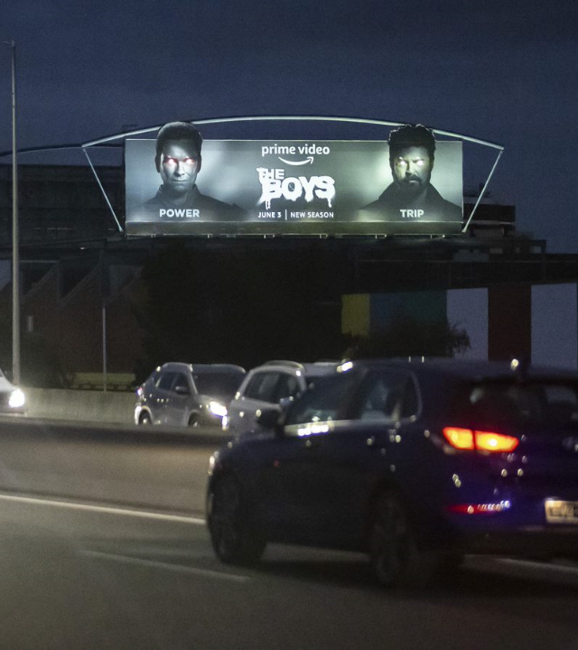
Increasing investment in traditional
19.8%
of marketers in the US say they are extending their reach and investing more in traditional advertising (outside of Online approaches).
Source: The CMO Survey, 2022, https://cmosurvey.org/results/

Slide 12
More research and insights may be found at Anatomy of Out of Home

