Slide 1
Audiences post
pandemic
October 2022

Slide 2
Small changes
Same audience
While the way we work has changed since the pandemic, Out of Home is still effective at reaching the masses.
A study published by the University of Sussex, found that hybrid workers in England travelled further each week than office-based workers, and those working remotely make more trips overall.
Read on for the highlights.

Slide 3
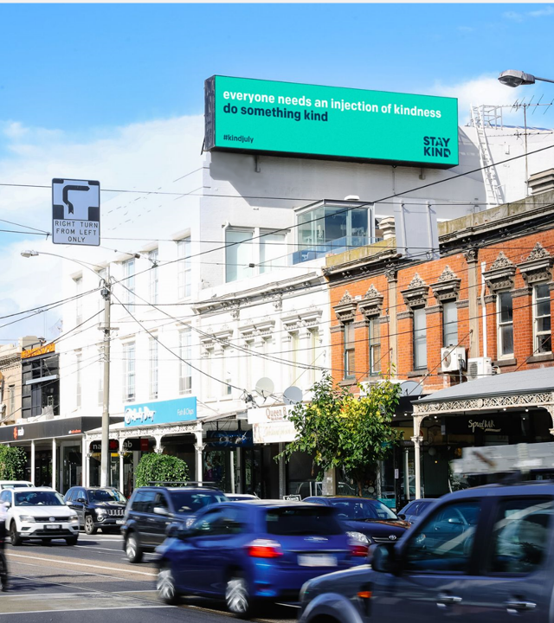
People travel further when hybrid working
11%
People who work from home once or twice a week travel 11% further each week than commuters who travel into work each day.
Source: Neil Vowles, University of Sussex, 2022 https://www.sussex.ac.uk/broadcast/read/57779

Slide 4
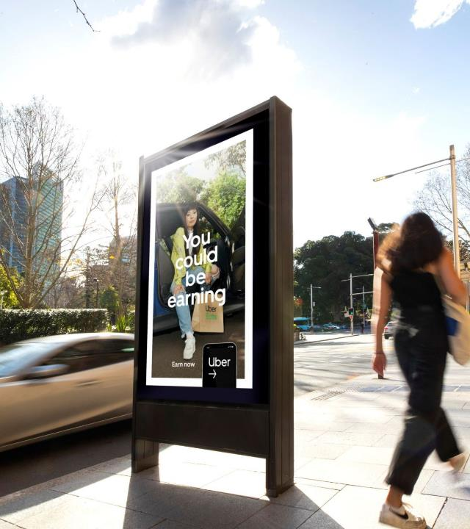
People make more trips while working remotely
8%
Remote workers took around 8% more trips for non-work purposes each week.
Source: Neil Vowles, University of Sussex, 2022 https://www.sussex.ac.uk/broadcast/read/57779

Slide 5
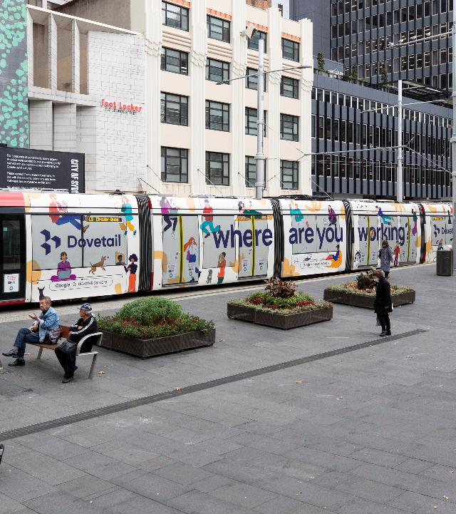
People want to be out in the world
70%
of 18-34-year-olds said they are now trying new things and interacting with the world in different ways post-pandemic.
Source: Hall & Partners, 2021, Consumer values shift for a post-pandemic world

Slide 6
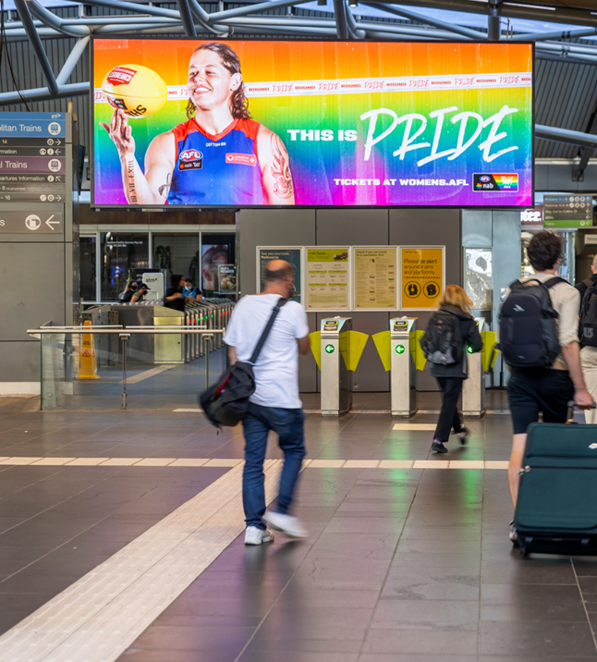
People remember OOH more now than before the pandemic
43%
adult consumers notice OOH ads more now than before the pandemic.
Source: AdWeek, Esther Raphael, 2022 Out-of-Home Ads Remain Effective in the Face of Inflation – Adweek (ampproject.org)

Slide 7
More research and insights may be found at Anatomy of Out of Home

