Slide 1
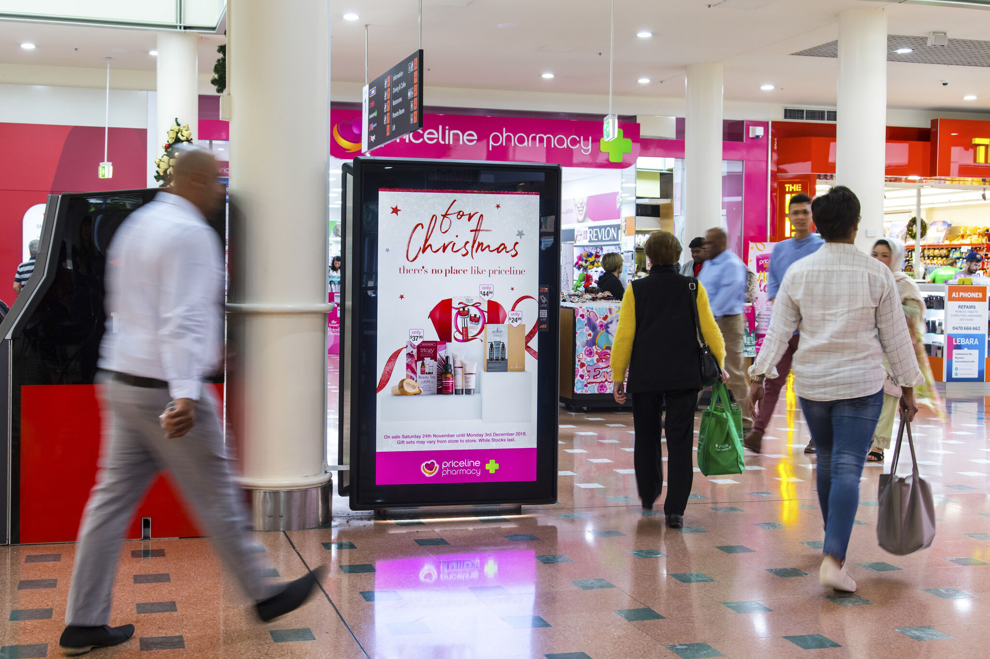
Shoppers are poised for pre-Christmas spend
October 2021

Slide 2
Retail sales predicted to increase pre-Christmas
As pandemic restrictions on the east coast ease, retailers forecast massive pre-Christmas spending for the second year in a row.
$58B
11.3%
In predicted pre-Christmas retail sales this year.
Anticipated increase in spending from pre-pandemic levels.
Source: ARA Roy Morgan 2021 pre-Christmas Retail Sales predictions, more.

Slide 3
Outdoor influences shoppers at the right time
Average time spent with media prior to a shopping occasion on the same day (in minutes).
Source: Source: Day in the Life study, Research Now, Total 14+ n=3,465. Shoppers defined as people leaving home to shop.

Slide 4
Outdoor influences three out of five shoppers prior to purchase
Percentage of customers exposed to media in the 60 minutes prior to shopping.
61%
Of shoppers will be exposed to Out of Home in the hour prior to visiting a retail store.
Source: Source: Day in the Life study, Research Now, Total 14+ n=3,465. Shoppers defined as people leaving home to shop.

Slide 5
Outdoor also influences Online and Mobile retail actions
Beyond bricks and mortar stores, Outdoor also drives people to make more Online searches and Mobile brand actions.
2.5X
17%
More Online activity per ad dollar spent is deliver by Outdoor compared to other offline media.*
Uplift in smartphone brand actions when exposed to Outdoor.**
Source: *Nielsen OOH Online Activation Survey Conducted March 20–30, 2017 on US adults. **Outsmart OutPerform study 2016.

Slide 6
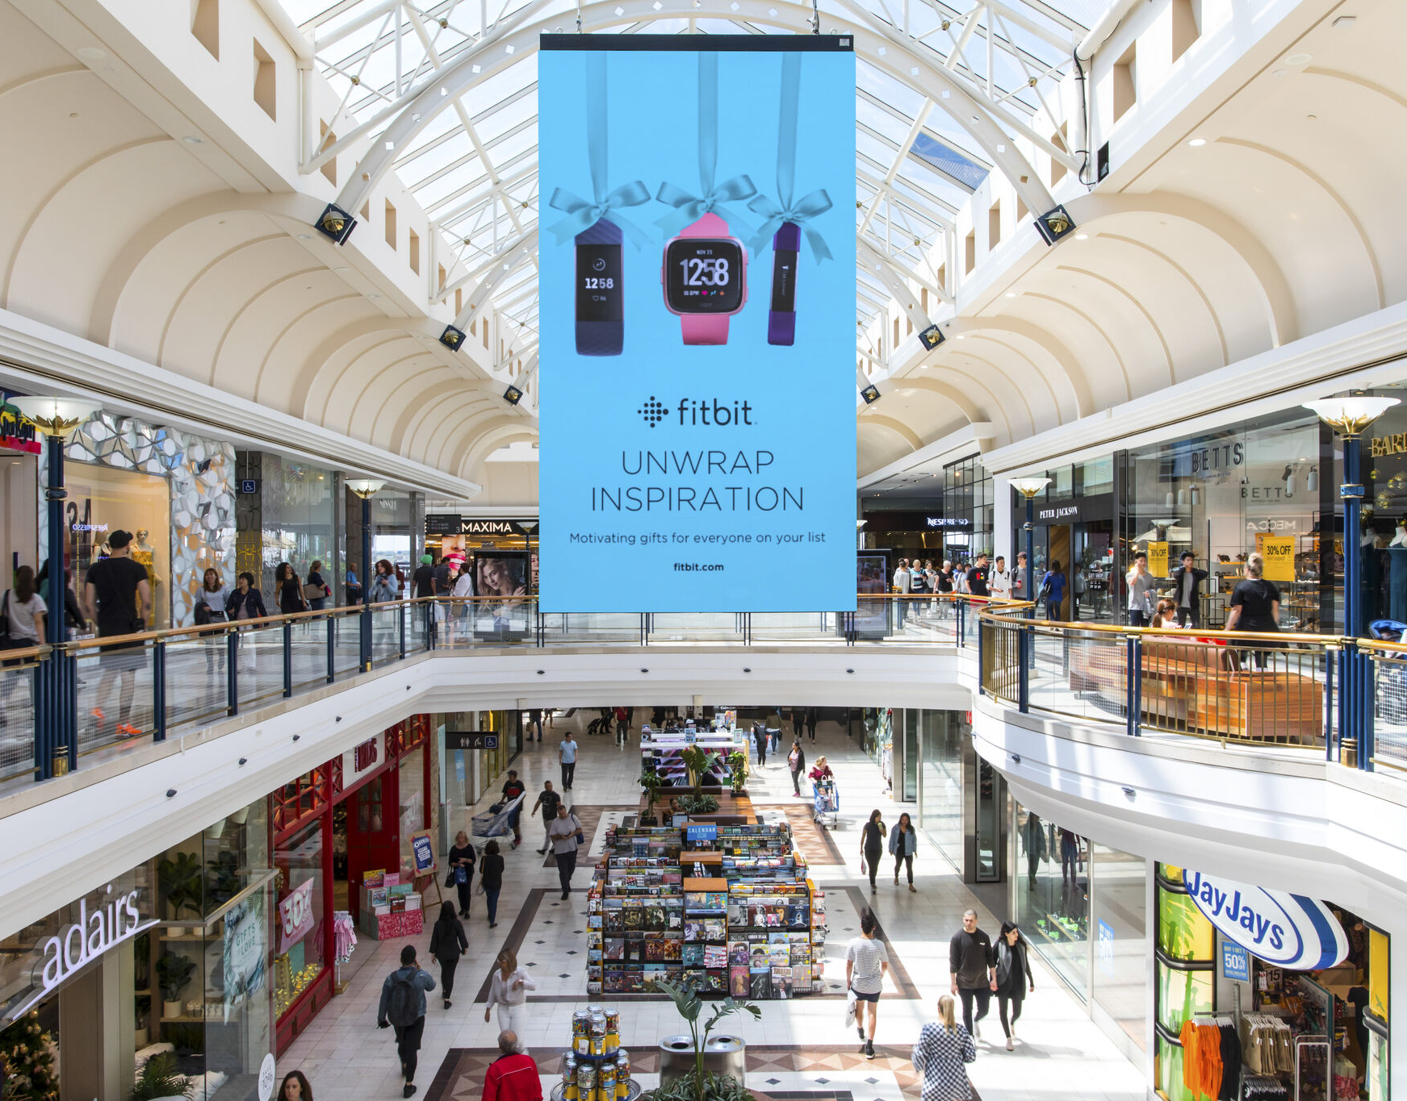
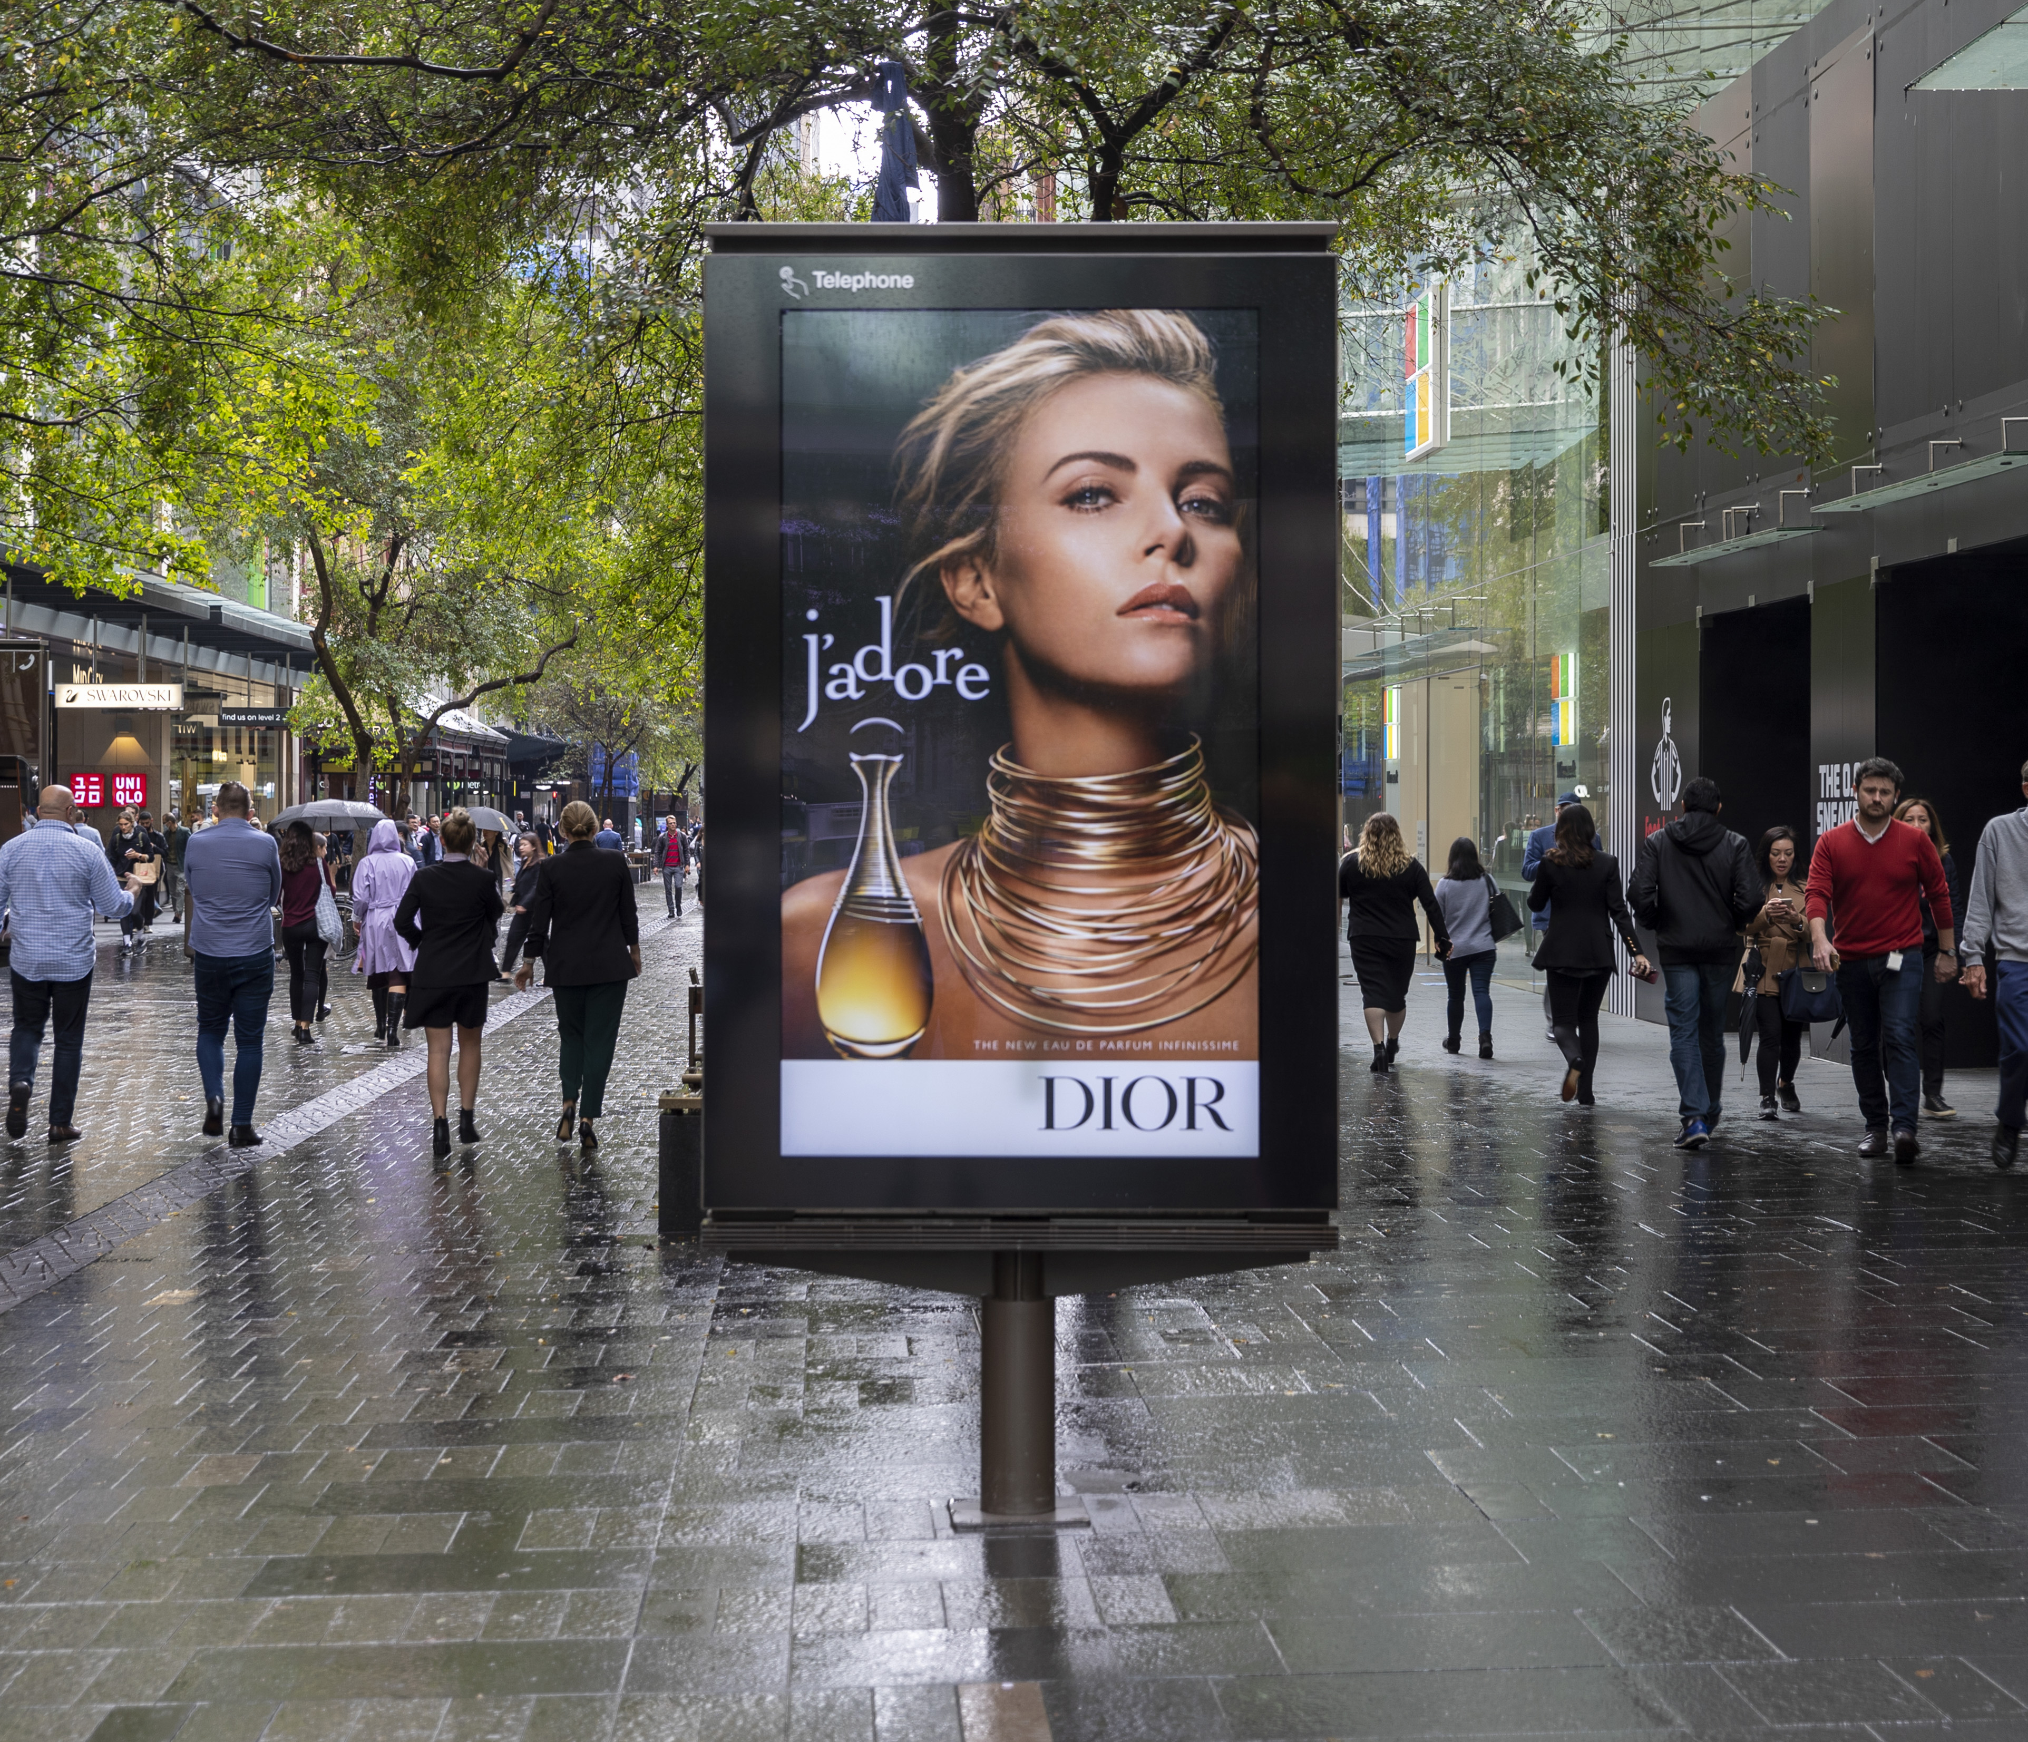
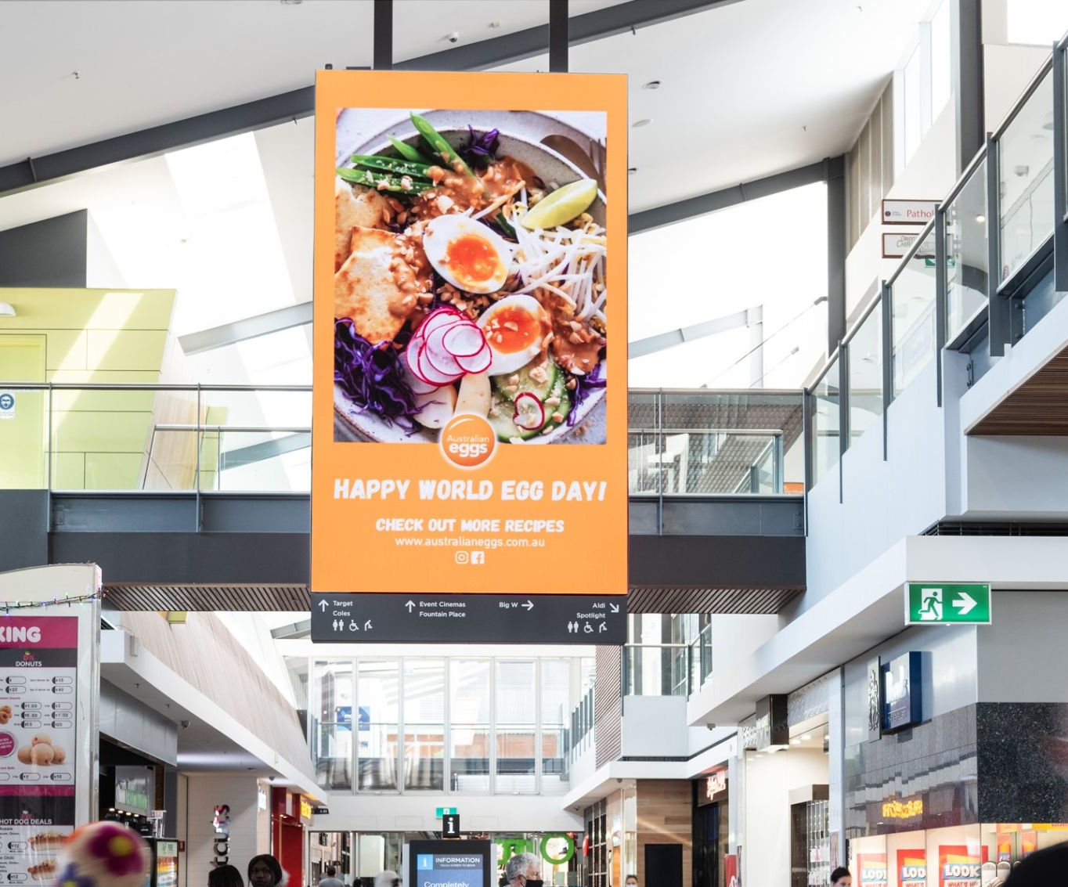
Outdoor is primed to reach shoppers this Christmas period

Slide 7
More research and insights may be found at Anatomy of Out of Home

