Slide 1
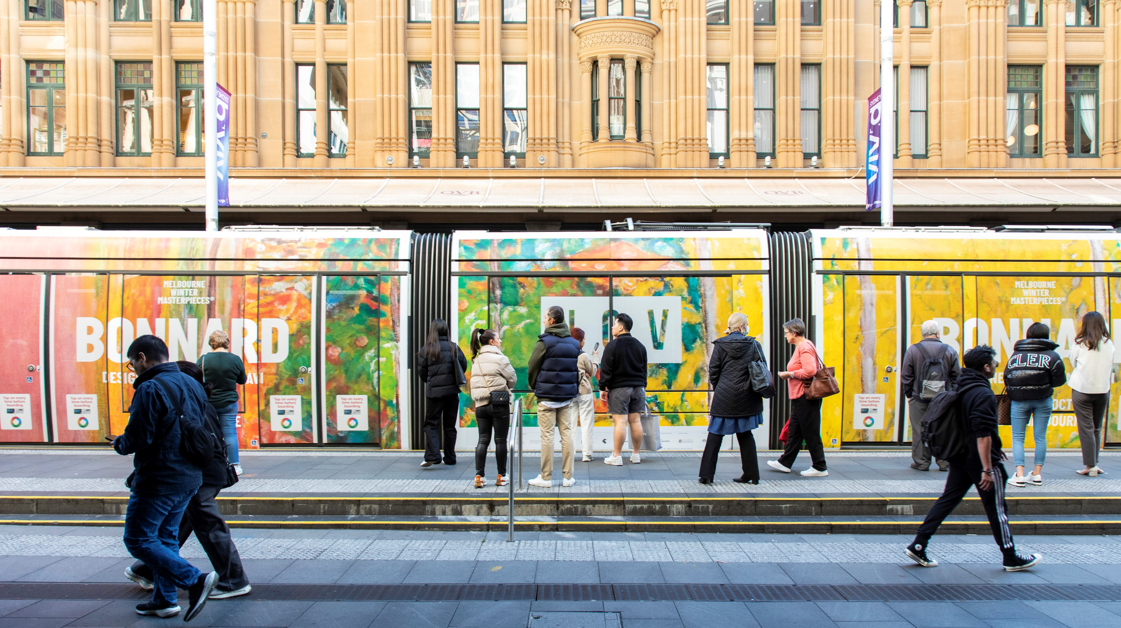
Special edition:
Public transport advertising
July 2023

Slide 2
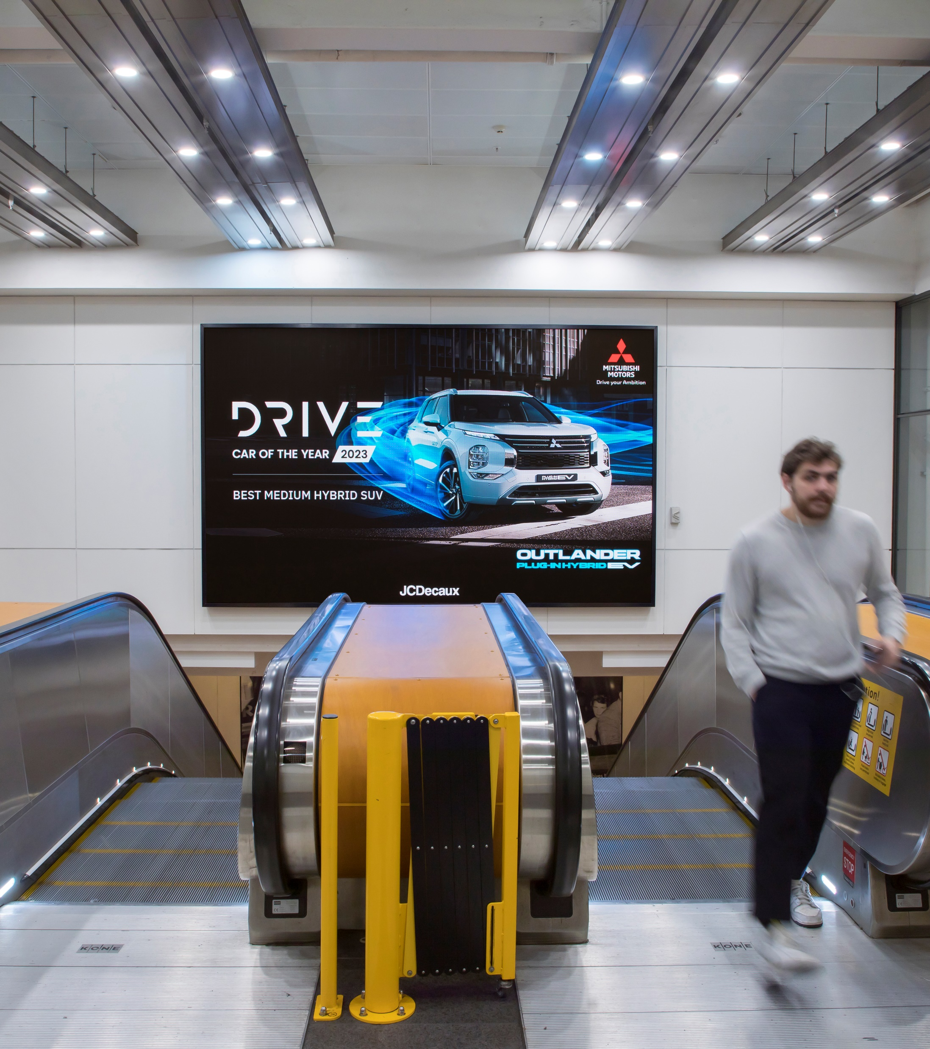
Public transport advertising is remembered & drives action
A recent study, commissioned by TorchMedia, profiled people using public transport across the five capital cities. The aim of the study was to gain a deeper understanding of advertising effectiveness via trains, buses, trams and ferries, as well as commuter behaviours when travelling.
In this Anatomy of Out of Home, we share some of the key stats that show why transport advertising is so effective.
Enroute to Engage: Transit Media Effectiveness Study, TorchMedia and GfK Consumer Intelligence & Consulting, November 2022

Slide 3
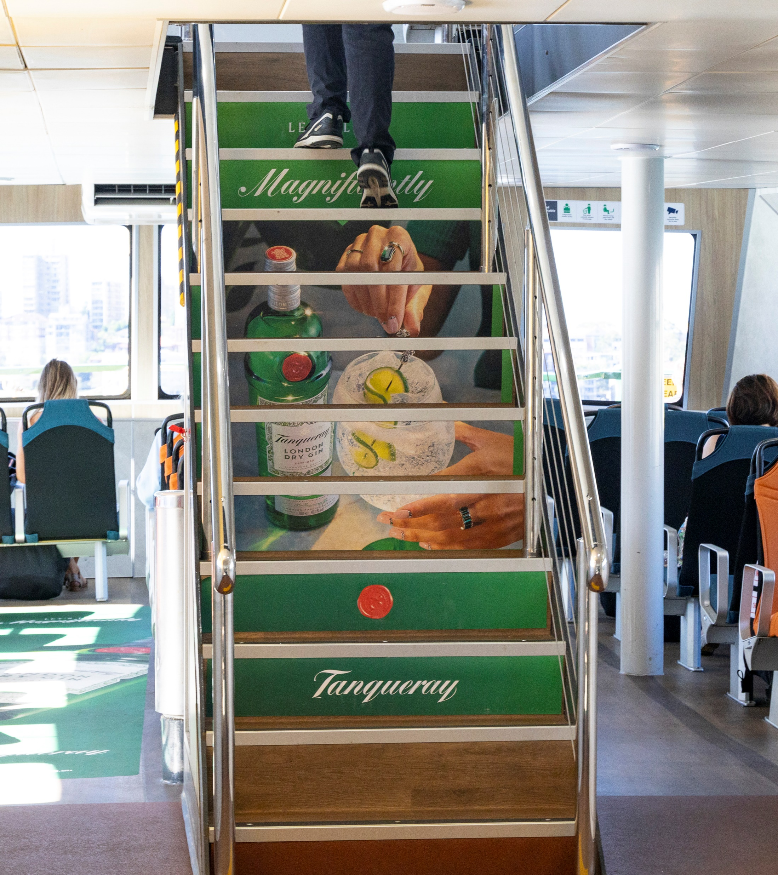
People remember the ads they see while travelling
42%
recall advertising they’ve seen while travelling on public transport.
Base: Total interviews (n = 527)
Reference: A2 (In the past month while travelling via [INSERT MODE], do you recall having seen any advertising in these areas?)

Slide 4
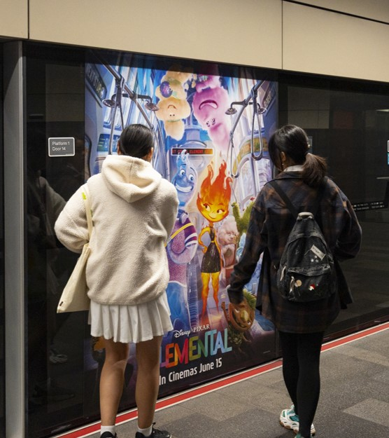
People remember the ads they see while waiting
47%
recall advertising they’ve seen while waiting for public transport.
Base: Total interviews (n = 527) Reference: A2 (In the past month while travelling via [INSERT MODE], do you recall having seen any advertising in these areas?)

Slide 5
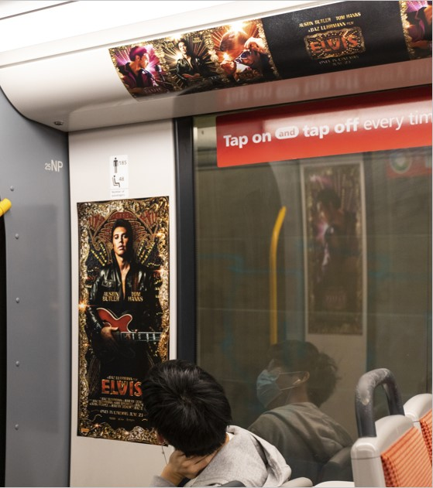
People on public transport seek more information
56%
say they would research products being advertised, if the advertisement was of interest to them.
Base: Total interviews (n = 527) Reference: Assuming that the product, event or service being advertised was of interest to you, which, if any, of the following would you most likely do after seeing ads like these?

Slide 6
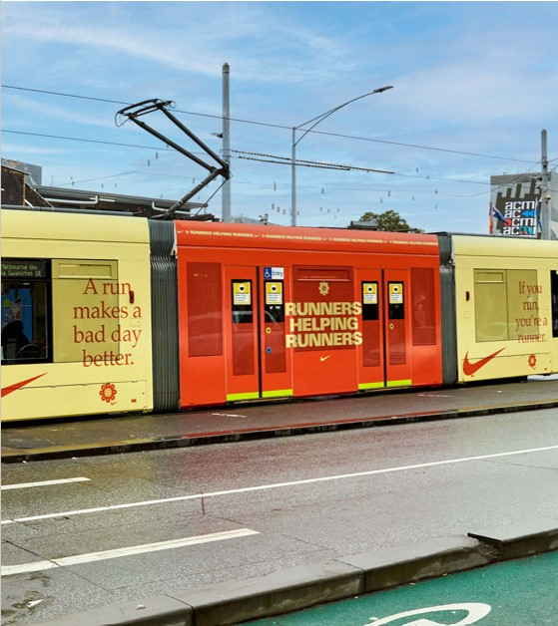
Transport advertising drives action
71%
have taken action within seven days after seeing an ad on public transport.
Base: Among who saw an ad in public transport (n = 404)
Reference: A2b (As a result of having seen advertising while travelling via [INSERT MODE], which, if any of the following have you done, either during your journey or within the same week you travelled?)

Slide 7
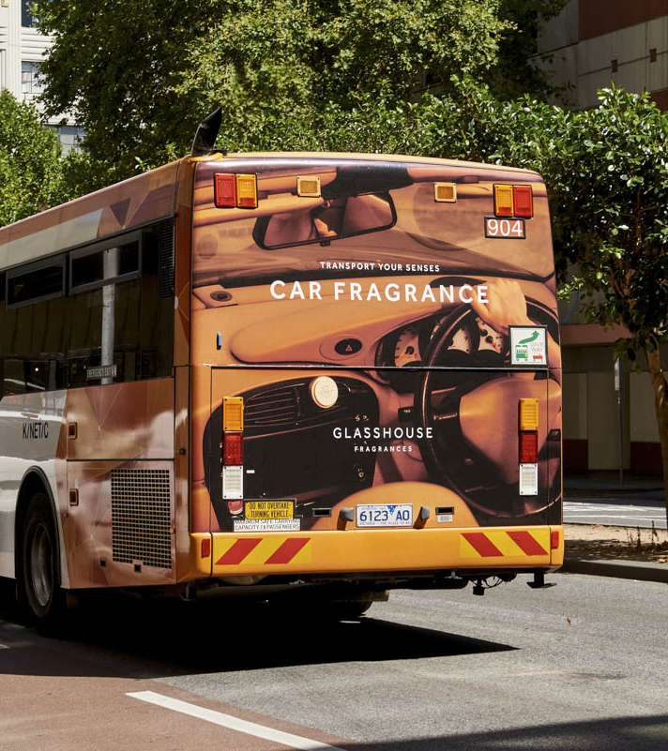
Transport advertising leads to purchases
14%
Have purchased a product being advertised within seven days after seeing an ad on public transport.
Base: Among who saw an ad in public transport (n = 404)
Reference: A2b (As a result of having seen advertising while travelling via [INSERT MODE], which, if any of the following have you done, either during your journey or within the same week you travelled?)

Slide 8
More research and insights may be found at Anatomy of Out of Home

