Slide 1
Special Edition: Global Insights
June 2023

Slide 2
How does OOH compare on the world stage?
This month, at the World Out of Home Conference in Lisbon, Mark Boidman from Solomon Partners, presented on the value of OOH in a global context.
In this Anatomy of OOH, we explore some of their key findings, including how OOH compares to other channels in reach, CPM and recall.
Solomon Partners, Mark Boidman 2023 WOO presentation.

Slide 3
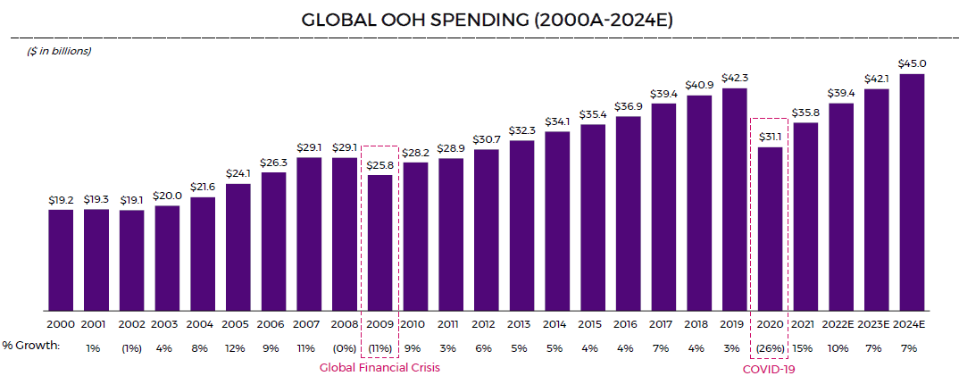
Global OOH Market Growth
In 23 years, OOH has only experienced real negative growth twice.
Zenith, Statista

Slide 4
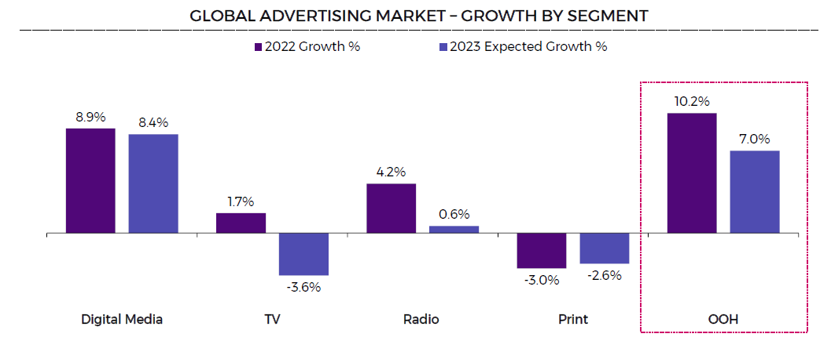
The global advertising market is shifting in a big way…
OOH is poised to continue to take share from other channels as consumers continue to spend time outside their homes.
MAGNA Global, Zenith.
Note: Digital Media includes search, social and digital video.

Slide 5
OOH is the best bang for your buck
Price matters, and OOH gets cost effective reach.
Solomon Partners Estimates as of January 2022 based on SEC filings, news, research and other industry sources.
a)30 second advertisement. Includes both primetime and non primetime viewing.
b) Represents range for radio and podcasts. Represents 60 second advertisement for podcasts and 30 second advertisement (both spot and network) for radio.
c) Represents range for OTT, mobile video and desktop video. OTT dataset includes various network and subscription streaming services. Mobile and desktop video represents data from 2018. Mobile dataset includes mobile web, phone and tablet for both Android and iPhone.
d) Represents range of mobile display and general display 300x250 banner ads. Data from 2018. Mobile dataset includes mobile web, phone and tablet for both Android and iPhone.
e) Represents range of bulletins, posters, transit shelters and digital place based media. Calculated using SQAD reporting from OOH media companies. Digital place based media represents a range of average realized direct and programmatic rates on various on premise media / place based digital networks.
f) Represents range of newspapers and magazines. Newspapers represent ½ page ads, calculated using estimated readership. Magazines represent full page color ads, calculated using estimated readership.
© 2023 | Solomon Partners. All rights reserved.

Slide 6
OOH ad recall outpaces digital/mobile
OOH stands out and has the best recall.
Sources: Vistar (2022), Nielsen (2022), tvScientific (2021), The Drum (2021), Kickstand Communications (2021), Nielsen (2020), Thinkbox (2020), Comcast (2020), National Library of Medicine (2020), Talon Outdoor (2019), Comcast. Effectv and MediaScience (2019), Survata (2019), The Harris Poll (2019), IAB (2019), Ipsos (2019), Coda (2016-2018), Magna Global (2018), Nielsen Case Campaign Effect Study
(2017), True Impact, Canada Post.
Note: Advertising recall defined as advertising effectiveness in which respondents were exposed to an advertisement and then at a later point in time, respondents were asked if they remembered the advertisement on an aided or unaided basis.
Note: Represents aggregation of publicly available studies on advertising recall from 2017 – 2022. Ranges shift depending on aided vs. unaided recall basis, length of time for recall and sample size / nature and scope.
a) Includes interactive and non-interactive banner ads that appear embedded in mobile websites, downloaded apps or in mobile games on smartphones and tablets. Does not include text ads via short message service (SMS).
b) Includes all forms of desktop display advertising on websites, including text, image, flash, video and audio.
c) Includes all forms of outdoor advertising, including billboards, posters, wallscapes, rotary programs, transit, airport advertising and in retail venues.
d) Includes digital media used for marketing outside of the home and includes digital billboards, digital placed based networks and digital signage..

Slide 7
More research and insights may be found at Anatomy of Out of Home

