Slide 1
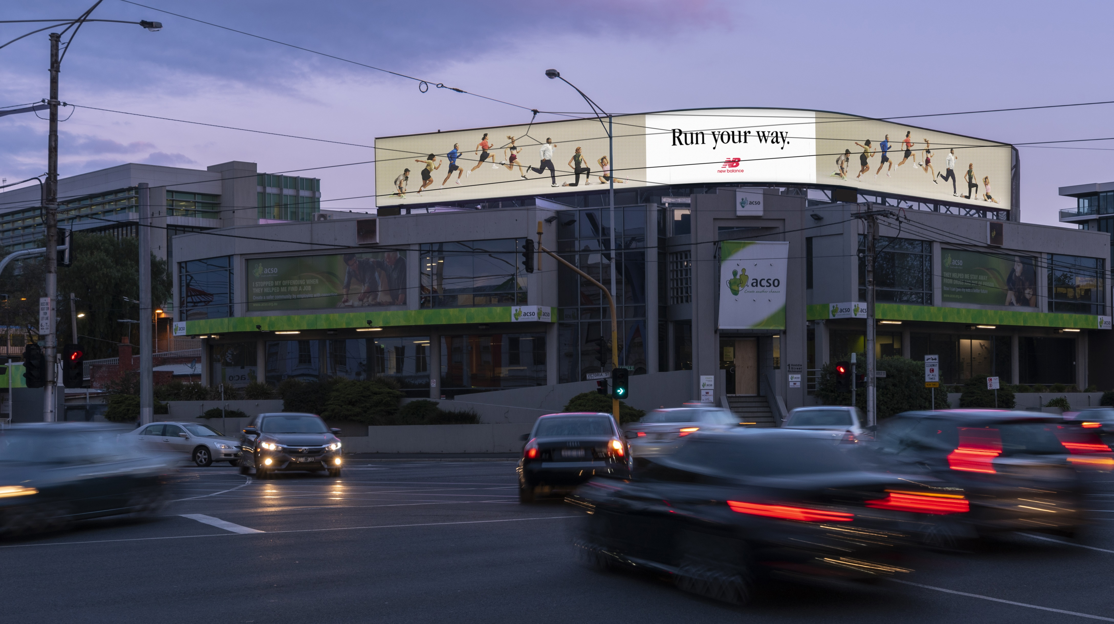
The priming effect of DOOH on Social Media
May 2023

Slide 2
DOOH + Social increases emotion and recall
We know that social posts can amplify OOH and DOOH campaigns, but does this also work vice versa? A new study from Ocean Outdoor and Neuro-Insight explores the influence of Digital OOH (DOOH) in building effective social media campaigns.
The 2023 study found that individuals are drawn towards brands on social media when they have seen them on DOOH first.
Neuro-Insight UK: Establishing the influence of digital out-of-home in building effective social media campaigns; May 2023 commissioned by Ocean Outdoor.

Slide 3
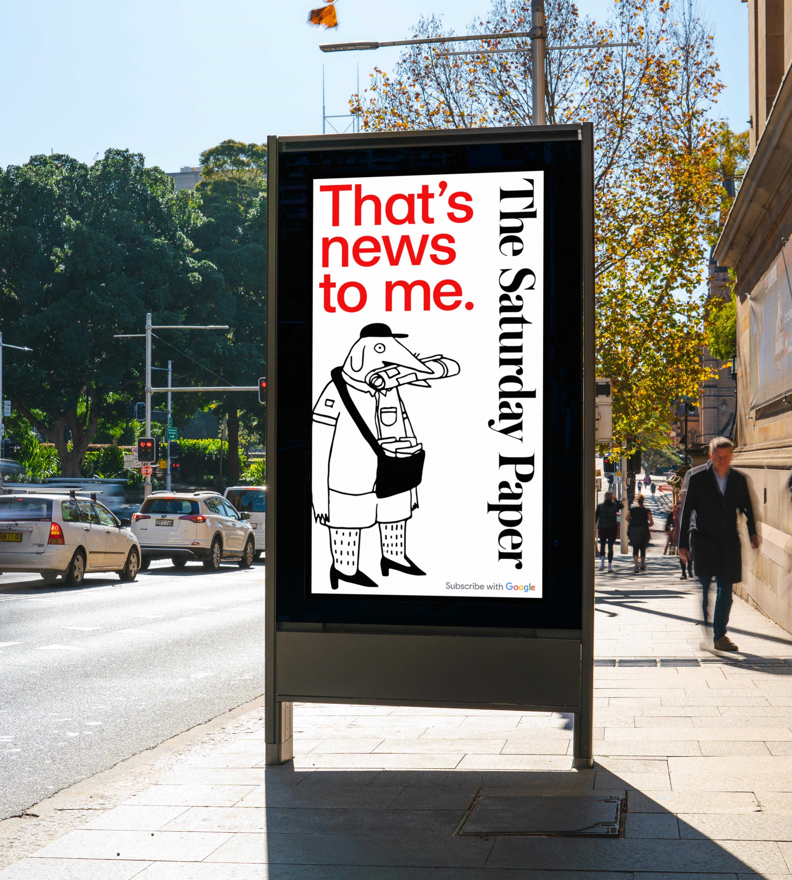
Increase emotional intensity on social posts by using DOOH
18%
The study found an 18 per cent increase in emotional intensity for social amplification posts when they were primed* by premium DOOH sites.
*Priming is the idea that exposure to one stimulus may influence a response to a subsequent stimulus, without conscious guidance or intention.
Neuro-Insights UK: Establishing the influence of digital out-of-home in building effective social media campaigns; May 2023 commissioned by Ocean Outdoor.

Slide 4
DOOH makes your Tik Tok & Insta content more likeable
87%
The study revealed an 87 per cent increase in approach* when DOOH was used to prime a social media brand post.
*Making the advertising more likeable and welcoming.
Neuro-Insights UK: Establishing the influence of digital out-of-home in building effective social media campaigns; May 2023 commissioned by Ocean Outdoor.

Slide 5
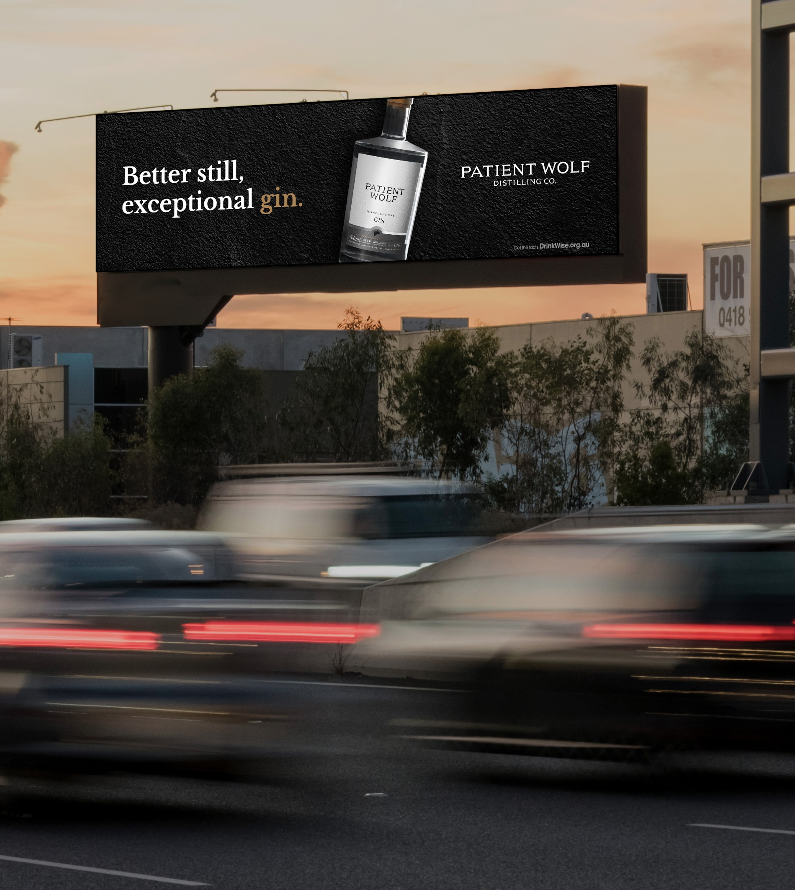
DOOH makes brands more memorable
5%
A five per cent increase in memory composite* was found for brands on social media when they had seen the brand campaign on DOOH first.
*The Ads were more memorable for brands on social media when they had seen the brand campaign on DOOH first.
Neuro-Insights UK: Establishing the influence of digital out-of-home in building effective social media campaigns; May 2023 commissioned by Ocean Outdoor.

Slide 6
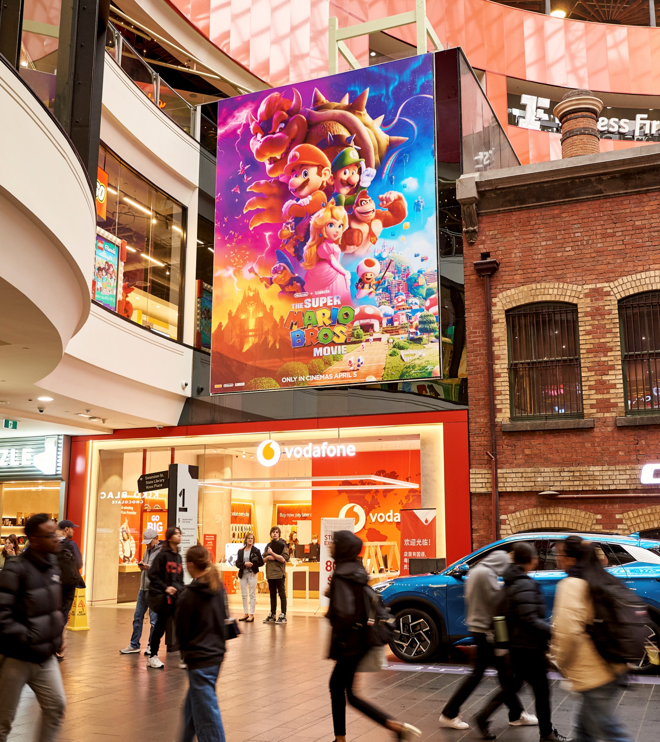
DOOH makes people engage more with social media posts
32%
Participants experienced a 32 per cent increase in dwell time with the social brand post when it was primed* by DOOH.
*Priming is the idea that exposure to one stimulus may influence a response to a subsequent stimulus, without conscious guidance or intention.
Neuro-Insights UK: Establishing the influence of digital out-of-home in building effective social media campaigns; May 2023 commissioned by Ocean Outdoor.

Slide 7
More research and insights may be found at Anatomy of Out of Home

