Slide 1


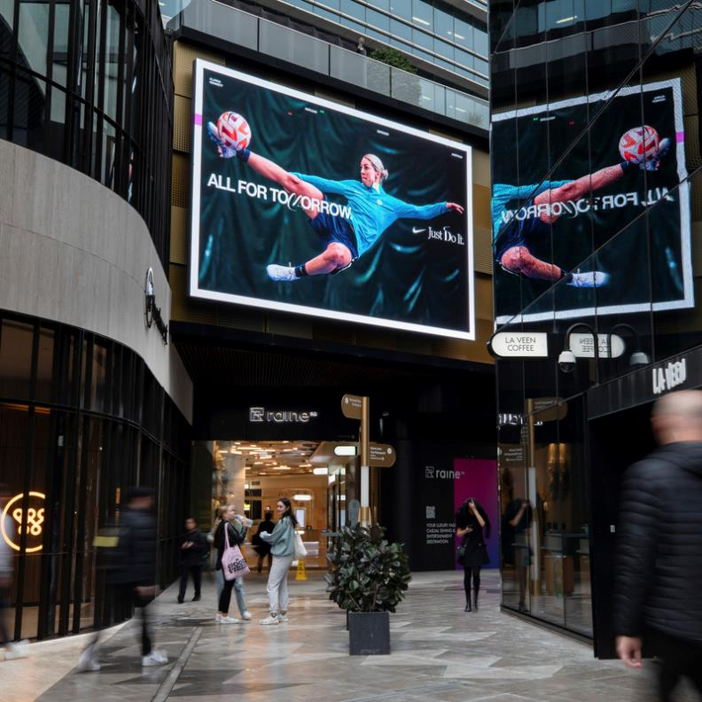
Best of the Year
2023

Slide 2
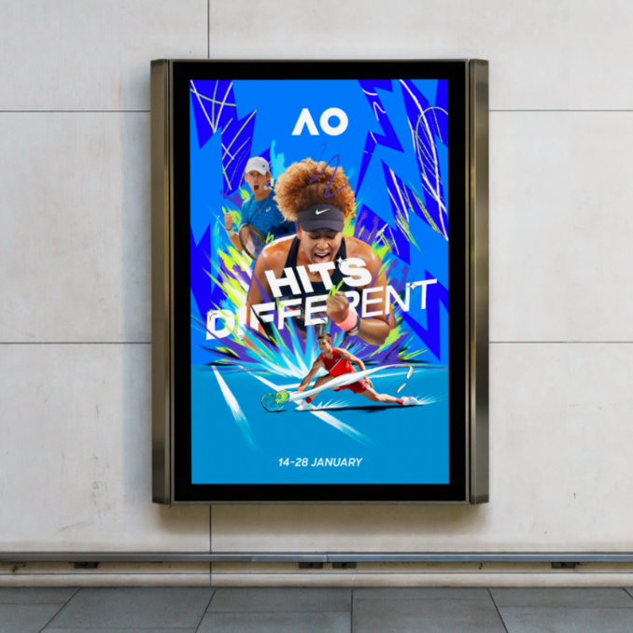
Our best insights
2023
It’s been a big year in Outdoor and evidence-based research fuels our success.
In this month’s Anatomy of Out of Home, we look back on the key takeaways and stats from 2023, from the OMA’s Out of Home Toolkit, the MOVE Mobility survey, Neuro Insight UK, Nielsen, Kantar and more!

Slide 3
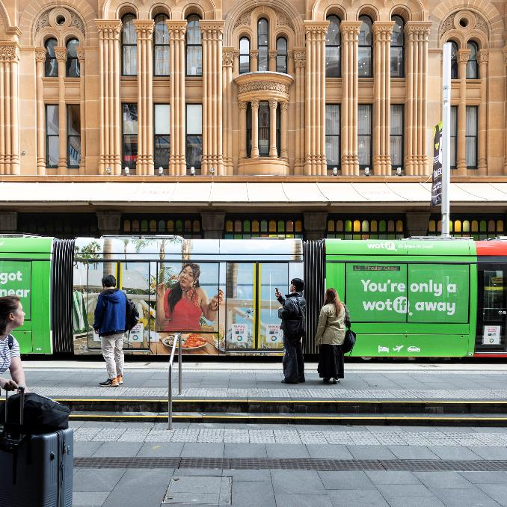
Out of Home advertising reaches most Aussies each Day
82%
of people in metro markets leave home each day.
MOVE 2.0 Mobility Survey Jan-July 2022 n 2,150

Slide 4
All people are Out of Home
Dynata & Thrive Insights for MOVE; Day in the Life November 2022; N= 2,962.

Slide 5
Using more Out of Home formats improves ROI
Analytic Partners; Collected Mix Models from The Leading Edge & Analytic Partners 2002-2018
Notes:
This recommendation is supported by the Analytic Partners study we showed you earlier. What you can see here is that using more Out Of Home formats will deliver a greater ROI.
For example, using two Out of Home Formats delivered on average a 21% higher return on investment than using a single Out Of Home format.

Slide 6
Out of Home enhances ROI of campaigns
Analytic Partners; Collected Mix Models from The Leading Edge & Analytic Partners 2002-2018
Notes:
An understanding of this comes from the study conducted by Analytic Partners, which scrutinised the incremental ROI of using different combinations of media, compared to using TV alone.
CLICK
For example:
What we see here is that the ROI of campaigns that combined Out Of Home with television, were on average 17% higher than those campaigns which use television alone. All of these campaigns are on a similar budget.
CLICK
And campaigns that included Out Of Home with digital and television, performed better than digital and television only campaigns.

Slide 7
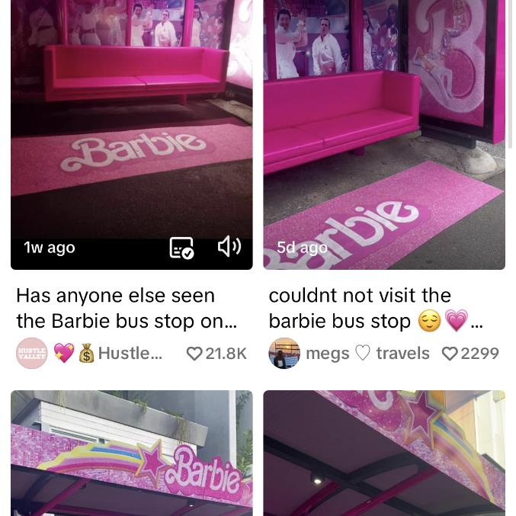
Digital OOH makes your Tik Tok & Insta content more ‘likeable’
87%
A Neuro-Insights UK study revealed an 87 per cent increase in approach* when DOOH was used to prime a social media brand post.
*Making the advertising more likeable and welcoming.
Neuro-Insights UK: Establishing the influence of digital out-of-home in building effective social media campaigns; May 2023 commissioned by Ocean Outdoor.

Slide 8
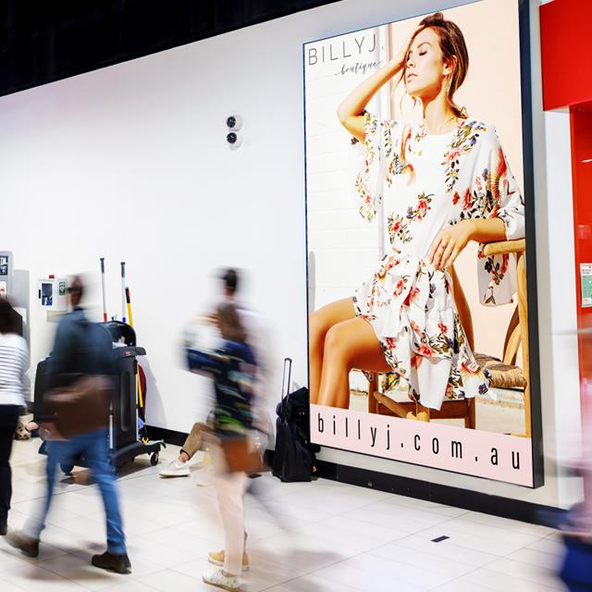
Frequent Flyers notice airport advertising
83%
of Frequent Flyers notice airport advertising.
Nielsen Study Reaffirms: Airport Advertising is Highly Effective & Drives Frequent Flyers to Act After Ad Exposure; 01/05/2023 commissioned by Clear Channel Outdoor.

Slide 9
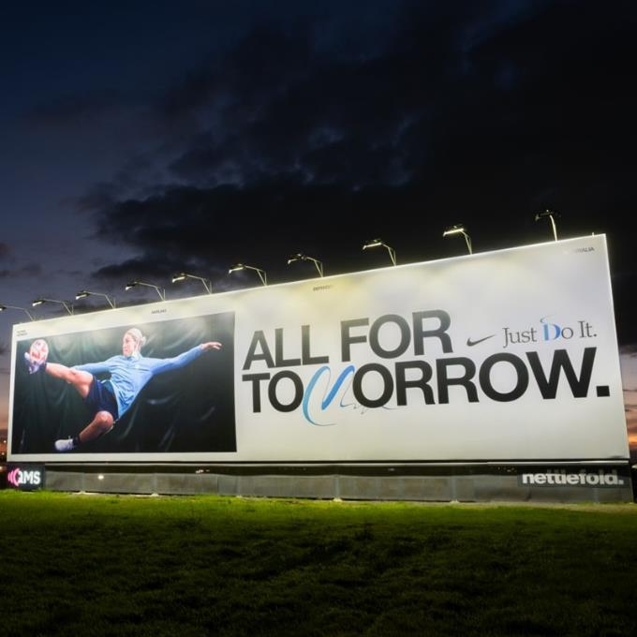
People pay more attention to channels they like
90%
There is a 90% correlation between media channels that consumers claim capture their attention and those in which they prefer seeing advertising.
Kantar: Media Reactions 2023 Braving the battleground

Slide 10
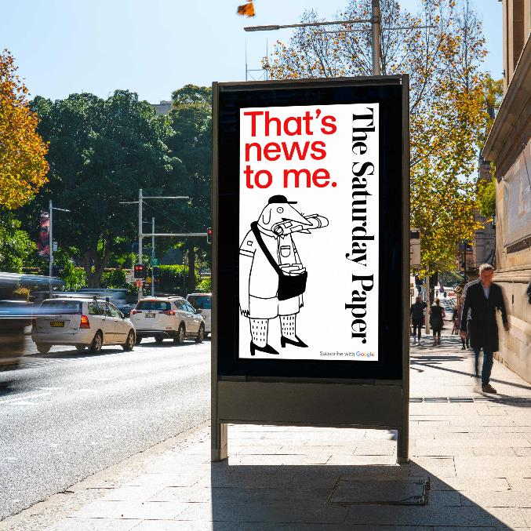
Digital OOH is the most innovative channel
#1
Both global consumers and marketers agree that DOOH is the most innovative media channel.
Kantar: Media Reactions 2023 Braving the battleground

Slide 11
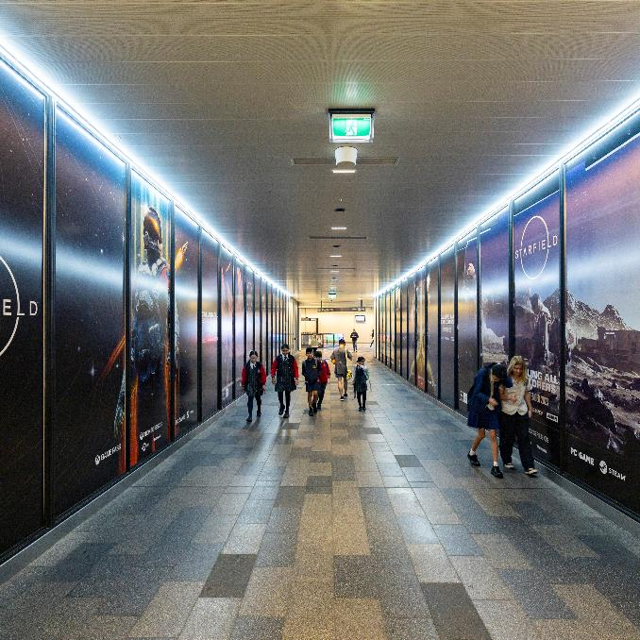
People on public transport seek more information
56%
say they would research products being advertised, if the advertisement was of interest to them.
Base: Total interviews (n = 527)
Reference: Assuming that the product, event or service being advertised was of interest to you, which, if any, of the following would you most likely do after seeing ads like these?
Enroute to Engage: Transit Media Effectiveness Study, TorchMedia and GfK Consumer Intelligence & Consulting, November 2022

Slide 12

The OMA’s Day in the Life study shows that Out of Home advertising…
#1 ‘makes a brand look desirable’
#1 ‘makes you aware of brands’
#2 ‘prompts you to try a brand’
#4 ‘makes you consider a brand’
Dynata & Thrive Insights for MOVE; Day in the Life November 2022; N= 2,962.

Slide 13
Classic and Digital Out of Home advertising delivers impact
Neuro Impact Factor (NIF) of different OOH formats and channels
623
284
270
254
247
172
163
152
131
100
Range
98
97
72
76
68
Classic
Radio
TV 15s
Digital OOH
TV 30s
Source: MOVE 2021 Neuroscience study for OOH + NeuroInsight’s vault of TV and Radio commercials
Notes:
This chart shows the range of impact achieved by both classic and digital formats, indexed to the average of classic. As you can see, on average, digital formats deliver a 63% higher impact than classic. That is the X-Factor.
So how does this compare to other media? What this graphic shows is that Out Of Home, which is a glance medium, still delivers impact that is comparable to other broadcast media..

Slide 14
More research and insights may be found at
Anatomy of Out of Home

