Slide 1


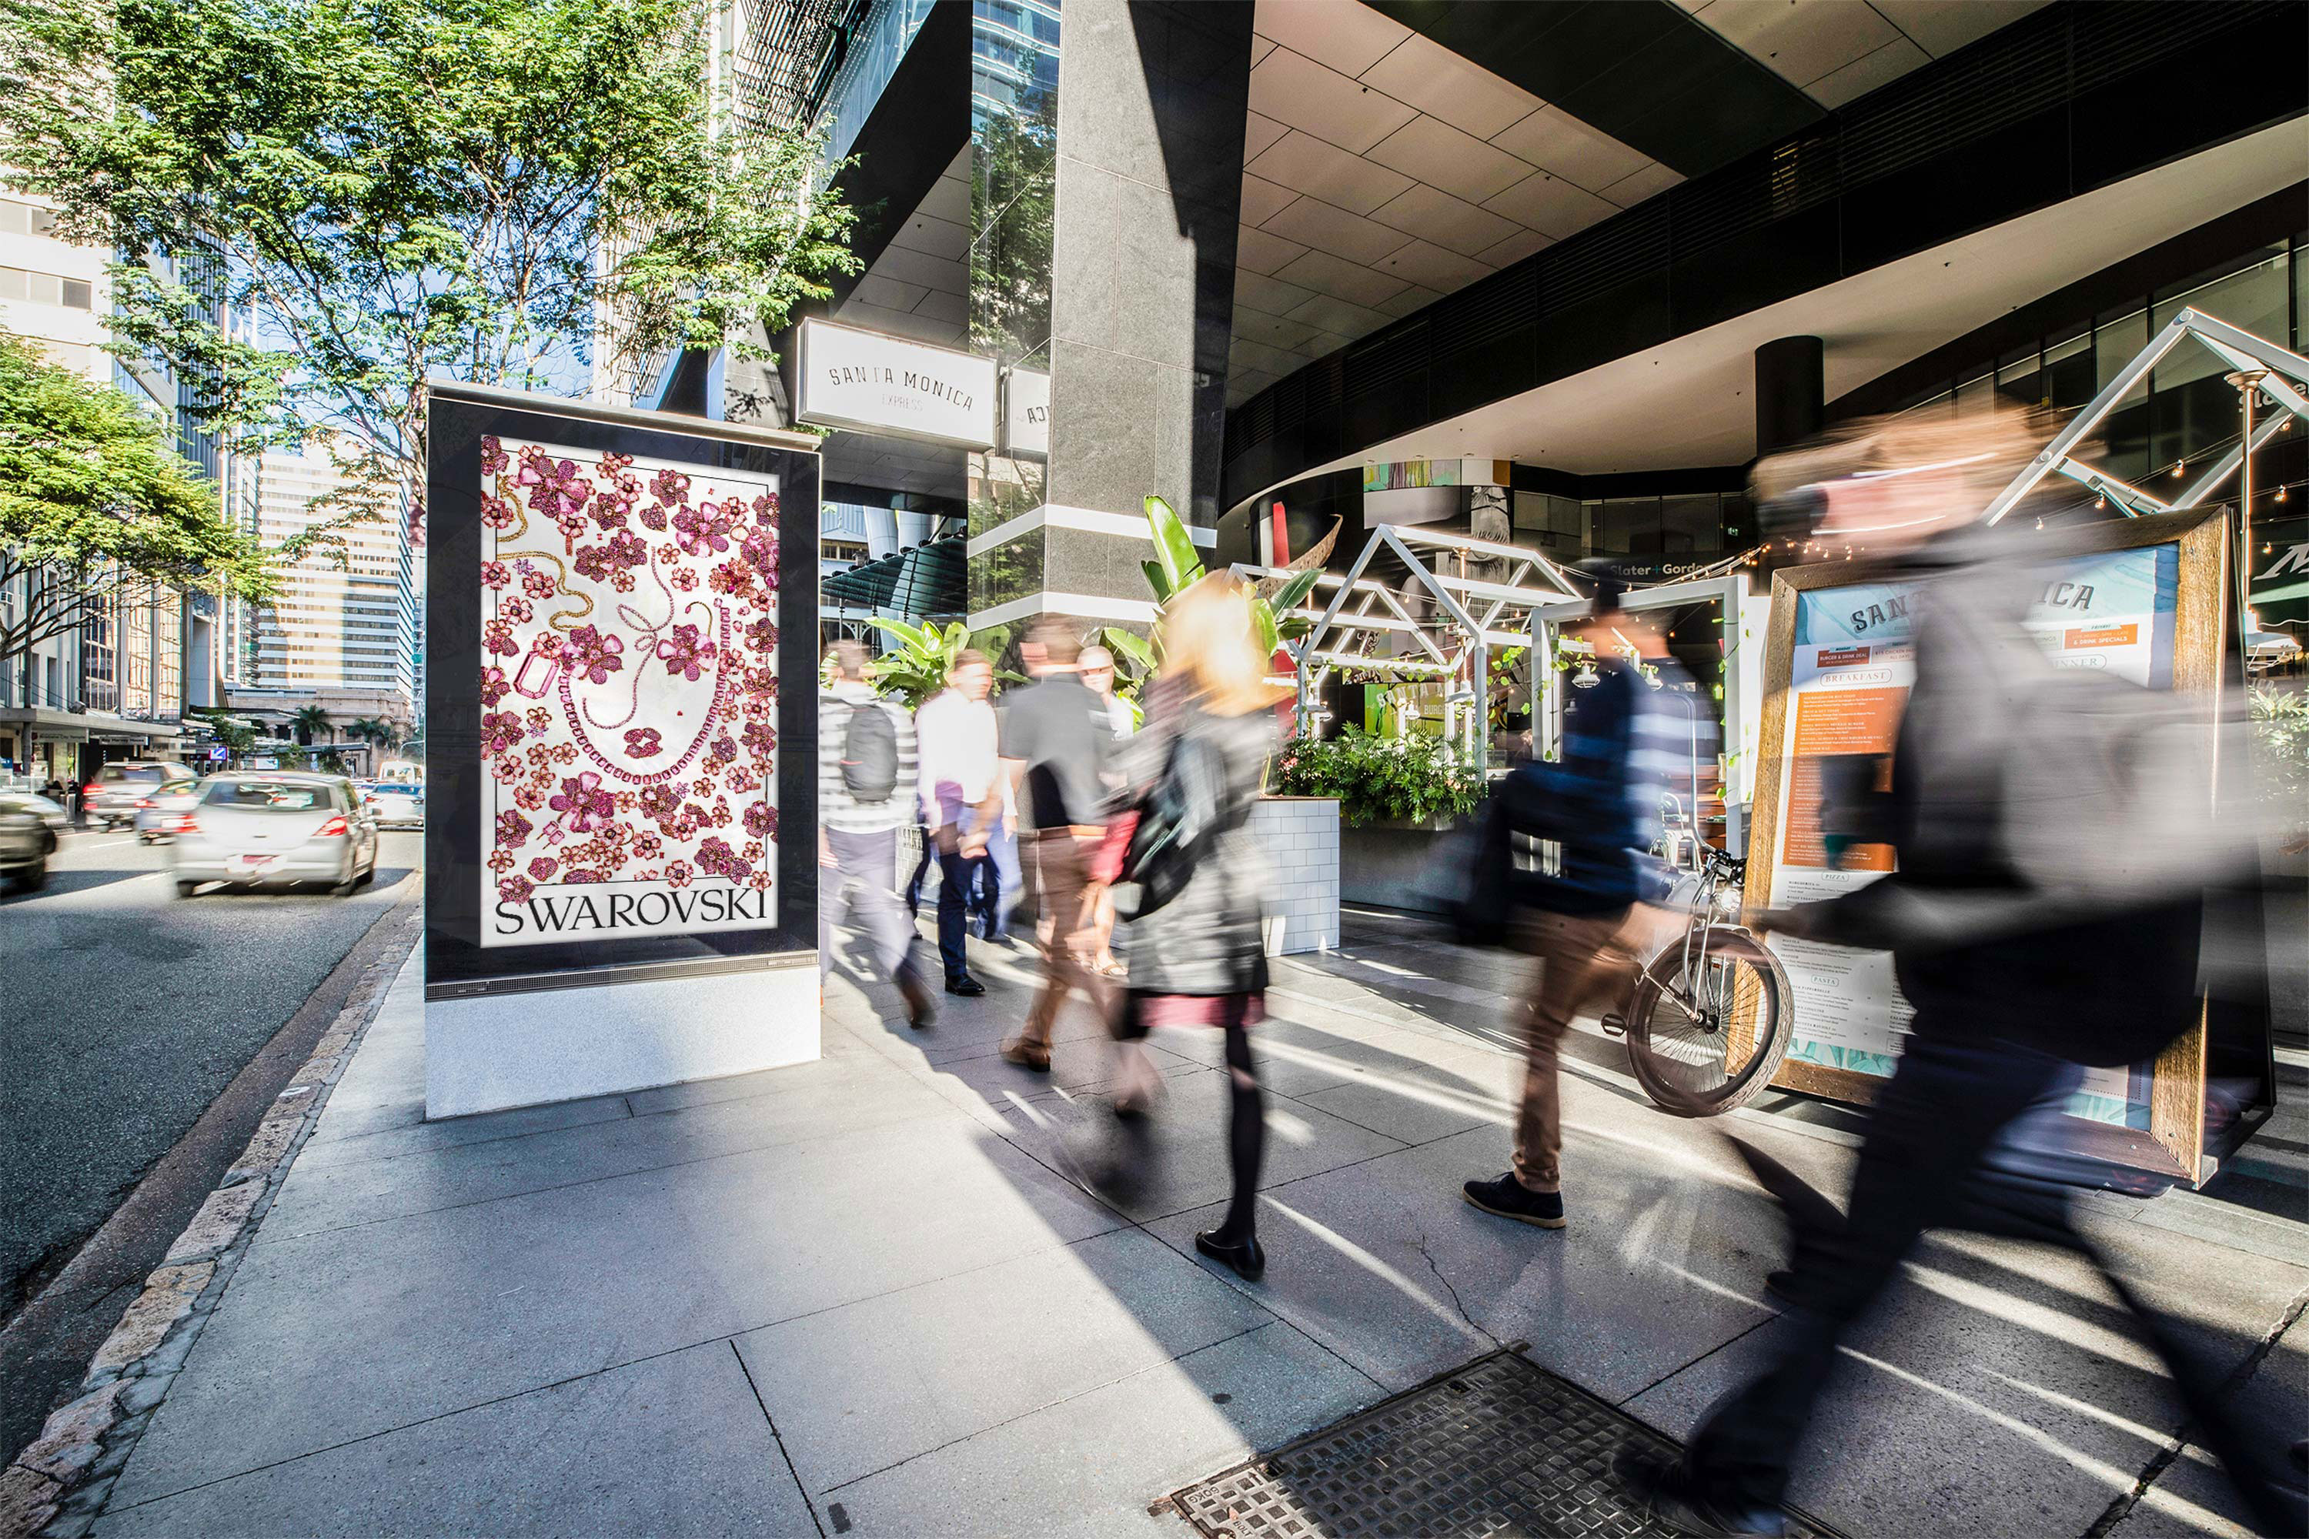
Kantar’s 2023
Media Reactions
September 2023

Slide 2

Consumers prefer
in-person advertising
Kantar’s 2023 Global Media Reactions report presents the preferences of media channels by consumers and marketers.
The top five channels for consumers are entirely in-person rather than online: Sponsored events, Cinema, Out of Home, Point of Sale and Digital Out of Home.
The top three channels for consumer attention are Cinema, Out of Home and Digital Out of Home. Read on for more of the findings.
Kantar: Media Reactions 2023 Braving the battleground

Slide 3
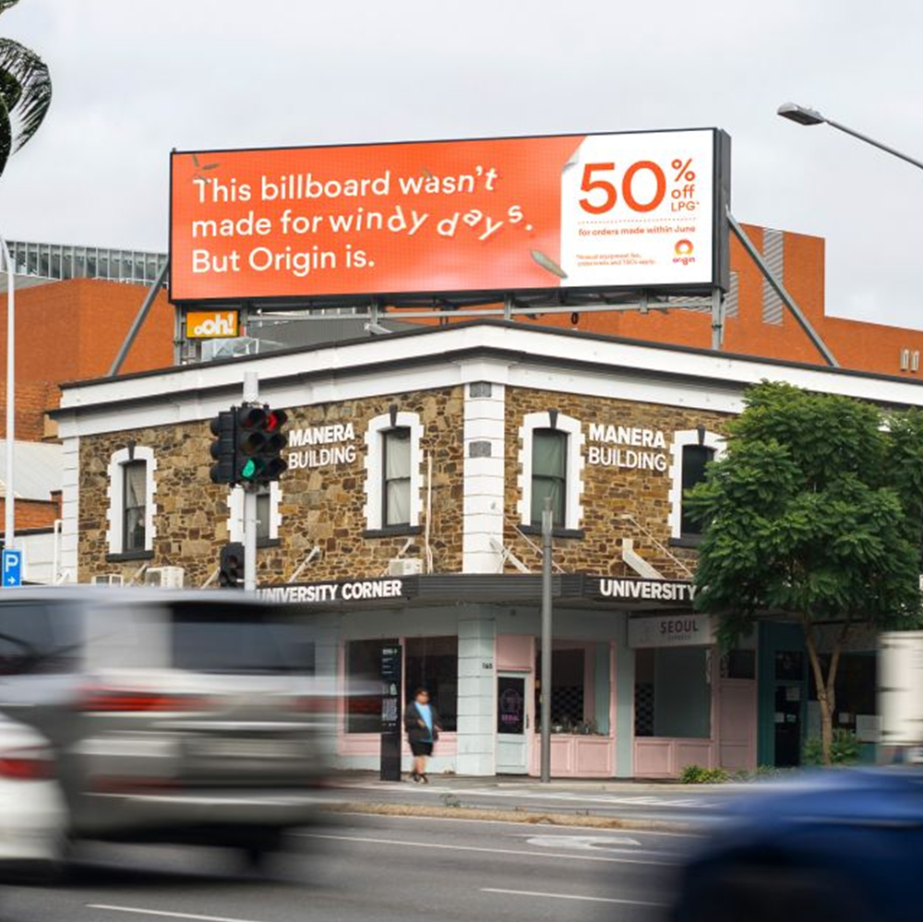
DOOH is the most innovative channel
#1
Both global consumers and marketers agree that DOOH is the most innovative media channel.
Kantar: Media Reactions 2023 Braving the battleground

Slide 4
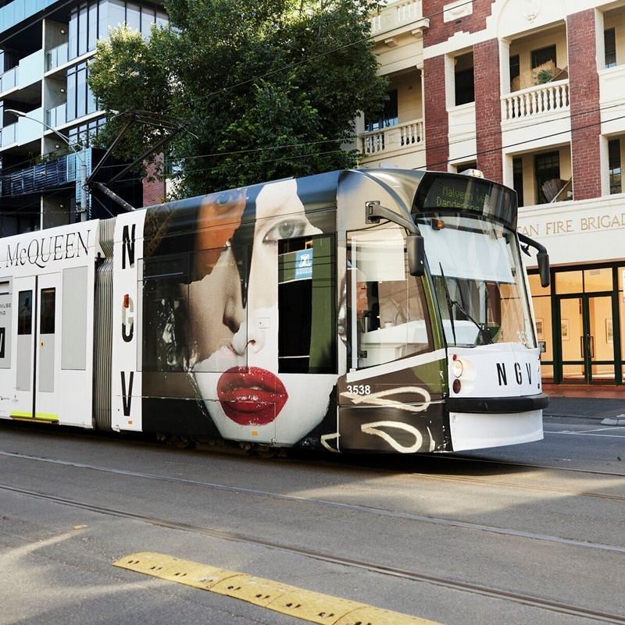
Global consumers like OOH
#3
Out of Home (OOH) ranked 3rd in global consumer’s top media channels, followed closely by Digital Out of Home (DOOH) in 5th place.
Kantar: Media Reactions 2023 Braving the battleground

Slide 5
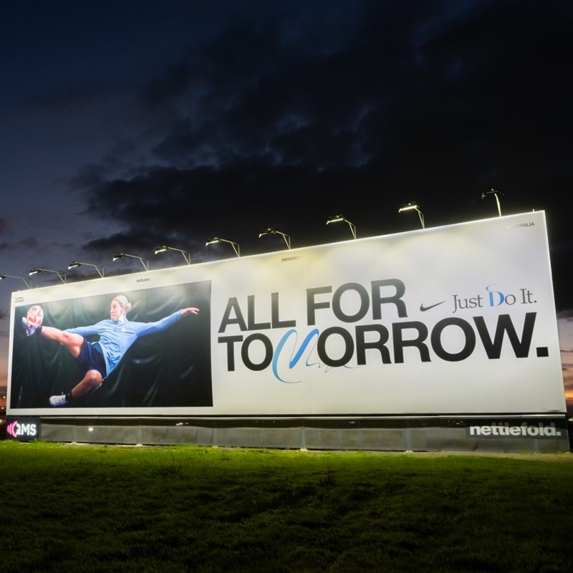
People pay more attention to channels they like
90%
There is a 90% correlation between media channels that consumers claim capture their attention and those in which they prefer seeing advertising.
Kantar: Media Reactions 2023 Braving the battleground

Slide 6
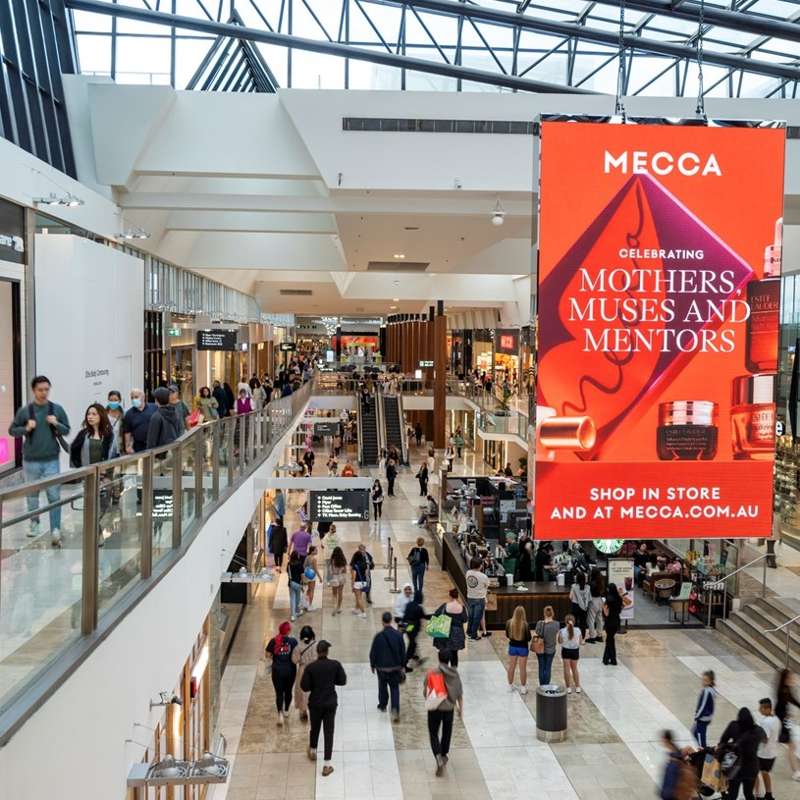
Global consumers believe both classic and digital OOH capture attention
#2
Classic OOH ads ranked 2nd and DOOH ads 3rd in capturing attention by global consumers.
Kantar: Media Reactions 2023 Braving the battleground

Slide 7
More research and insights may be found at
Anatomy of Out of Home

